Slide 1
Preparing for 4th year
Tyler Tantillo
ttantill@student.touro.edu
516-318-0603

Slide 2
General Objectives: Ortho Objectives:
Preparing for Board Exams/ Choosing board exams
Picking 3rd year rotations
Choosing a Residency Specialty
Setting Up Rotations
Audition Rotation Travel Advice
Preparing for Interviews
Pre-Interview Dinner Tips
Interview Questions You’ll Likely Encounter
Post-Interview Correspondence
Generating your Rank List
Is Orthopedics for You?
Preparing for Orthopedics
Building your Resume/ ERAS
What you should be doing during 3rd year
Letters of Recommendation
Scheduling Audition Rotations
Shining on Audition Rotations
Drafting a Personal Statement
OR Etiquette
Interview Practice Example

Slide 3
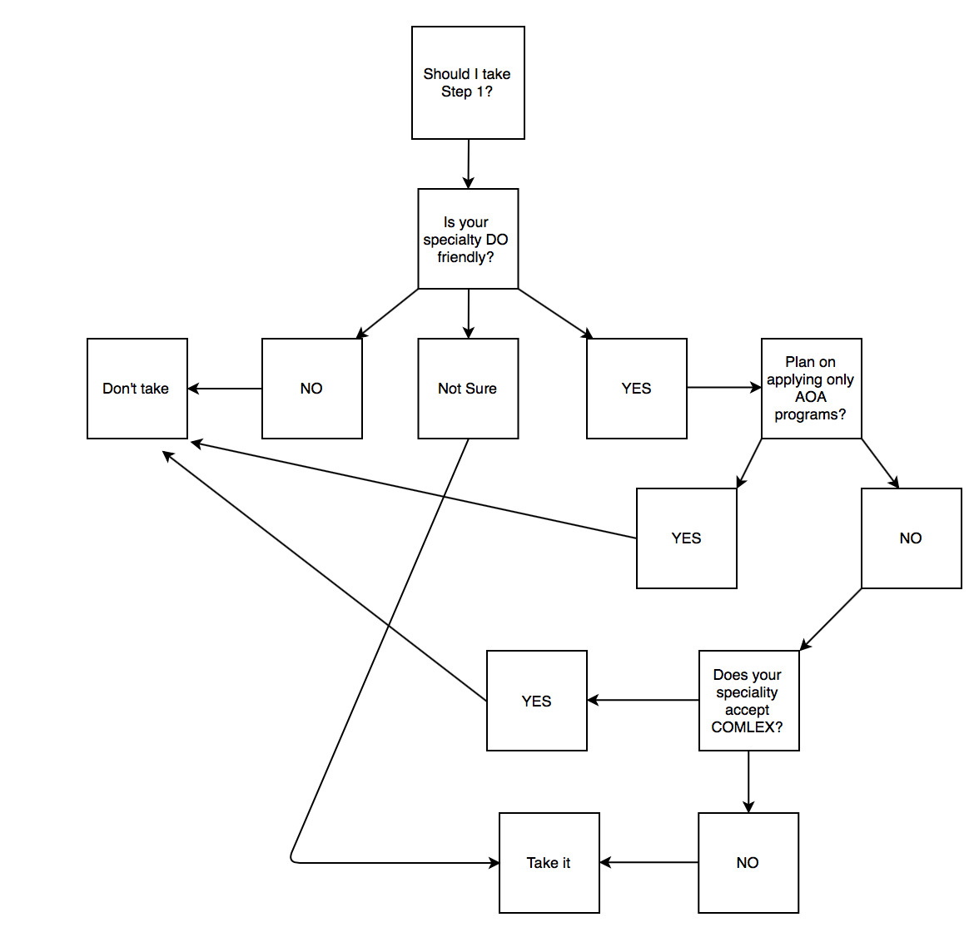
Should I take Step 1??
NO CLEAR CUT ANSWER…SORRY!
Specialty dependent
Requirements may change with merger

Slide 4
Level I/Step I Preparation: General:
Watch the lectures, attend class→ Schedule dependent (i.e. one month to study for boards)
Time frame: Start Jan/Feb. 2nd year; One month dedicated; Take exam June
Which to take first? Step 1; Schedule Level 1 for three-four days after
GOAL: See the material multiple times before taking exam

Slide 5
Level I/Step I Preparation: During School Yr
Read First Aid Chapter that corresponds to the module you are studying
UWORLD→ 40 questions every 3 days; TIMED→ 1hr per day
1 hr to take test
2-3 hrs to review→ READ EVERY EXPLANATION EVEN IF YOU GOT IT CORRECT!
Notebook: Write every wrong answer with explanation + random facts
Pathoma→ No brainer
Picmonic/Sketchy:
Picmonic: Make your own, self quizzes, shorter stories
GOAL: Finish UWORLD X1 ; Minimum 1-2 passes of FA

Slide 6
Level I/Step I Preparation: Dedicated Period
Wake up 6am (M-F)
Kaplan Videos/Lectures/Workbook (6am-12pm)
Follow along with FA and annotate accordingly
Lunch + Catch up work (12pm-1pm)
UWORLD; 40 question (1-2pm)
UWORLD Review (2-4/5pm)
Dinner (5-6pm)
Pathoma (6-8pm)
Picmonic (8-9/10)
SATURDAY→ Full length tests only (i.e. Two NBME)
Sunday→ Review test
Last two weeks→ Re-reading FA, Practice tests
OMM Saverese + Combank

Slide 7
Preparing for Level 2-CE
Uworld
Combank
Comquest
First Aid Step 2/ Fischers Book
COMLEX practice exams
PE Exam→ JB Review Book

Slide 8
Choosing 3yr Rotations
Hospital site preferred→ Learn the logistics of working with residents and attendings
Largely dependent upon what you put in
Schedule→ Elective + Vaction @ End of year

Slide 9
Choosing a Residency Specialty
Surgical vs. Non-Surgical
Patient Populations
Lifestyle Expectations
Interests vs. Talents
Realism

Slide 10
Setting up Rotations
SET THEM UP AS EARLY AS POSSIBLE!
VSAS vs. Direct Contact
Things to Consider:
Quality of Program
Geographic Location
Chosen specialty vs. Back-Up
Large vs. Small Program
Competitiveness of Specialty vs. Competitiveness of Applicant
Salary/Benefits

Slide 11
Audition Rotation Travel Advice
Most places offer student housing with residents
Pros: Cheap
Cons: You are always being watched, even if it’s a resident in different field (THEY ALL TALK TO EACH OTHER)
Other options: Airbnb, Craigslist, Hotels
Sign-up for every reward program possible
Flights: Again sign up for the reward program
Rental Cars: You will need a car at almost every audition rotation (specialty specific)
Turo
Hertz: If <25yo get AAA membership
Disability Insurance

Slide 12
Interviews
Congrats! You’ve succeeded on your auditions enough to get an interview…Now What?
PREPARE! PREPARE! PREPARE!...This is not the time to blow your chances!
Mock Interviews
Research common questions & questions specific to your field!
GENERATE YOUR STORIES!!
Practice with friends, family, and most importantly the mirror!

Slide 13
Preparing for Interviews
Research your specific specialty for prior interviews:
Format: One-on-One vs. Board; Residents vs. Attendings vs. Both
Length of Day: Know which times you perform better (i.e. morning person)
Question Style: Personal vs. Knowledge based
Reputation: Laid-Back vs. Intense
Mission statement, values, objectives
Backgrounds of your interviewers
Most important resource: RESIDENTS!!

Slide 14
Pre-Interview Dinner/ Meet & Greet
Show up on time→ Don’t play the “I’m going to show up casually late” or “I don’t want to be the first person there” game.
Dress professionally
1-2 drinks maximum
INTRODUCE YOURSELF TO EVERYONE
Have questions prepared:
How would you characterize the relationship between the residents and attendings?
How receptive is the PD/Administration to concerns raised by the residents?
Do you like the program/area? Any regrets?
Strengths/Weaknesses of Program?
MOST IMPORTANT: What will the interview be like tomorrow? Any tips??

Slide 15
Common Questions:
Tell me about yourself (HARDEST QUESTION TO ANSWER!!)
Why are you interested in _______?
Why this program?
You’re from _____. How will you handle residency if you don’t know anyone here?
What are your strengths and weaknesses?
What are your interests outside of medicine?
Describe yourself in 3 words. If I asked someone to describe you in 3 words, what would they say?
Tell me about a time when you failed, and how you handled it or learned from it?
What has been the hardest thing you have dealt with in life?
What is one thing you would change in ______?
What are your thoughts on the current state of the health care system?
If you could be any animal, what would you be and why?
If you could be any member in a rock band, what would you be and why?
Give me an example of an ethical situation you encountered and tell me how you handled it.
I see here you did ______. Tell me about that.
DO YOU HAVE ANY QUESTIONS? (2nd Hardest Question!)

Slide 16
Tell me about yourself…

Slide 17
Tell me about yourself… (MAX 5 mins)
Quick Intro: Sure, for those of you who don’t know me, my name is Tyler Tantillo and I’m 25 years old and originally from Long Island NY. I completed my undergraduate degree in Biology at Loyola University in Maryland after which I pursued a research position for about a year at Massachusetts General Hospital prior to being accepted to medical school at Touro College of Osteopathic medicine where I am currently a 4th year student.
Body: The reason I’m here today is because I have found an area of medicine in which I am truly passionate about. For me, orthopedics has solidified two areas in my life in which I have been pursing: helping other people and constantly learning. Ever since I was a teenager, I have worked in the customer service industry which I loved because I was able to meet so many different walks of life and help so many people. However, those jobs lacked the intellectually stimulating nature I was also drawn to. Orthopedics for me, has combined my passion for helping others and the desire to constantly enrich myself both as a person and academically. I personally love that orthopedics has so many different fields that you can get involved with, whether its patient care, research, or implant design and development that requires you to always keep learning. My hope is that by coming to your program, you will provide me with the education and foundation necessary to fulfill my passions and become an outstanding orthopedic surgeon and beyond.

Slide 18
Do you have any questions for us?
Strengths and weakness of your program?
Do you foresee any major changes to your program in the near future?
If you could describe your residency program in one word what would it be?
Aside from in-service training exams, how do you evaluate your residents?
Research requirements? Questions about the area?

Slide 19
Post-Interview Correspondence
Do I need to send thank-you’s?....YES!
How many should I send?
Send to PD only
Send to everyone who interviewed you
When should I send them?
How should I send them?
Hand-written vs. Email
BE PROFESSIONAL
Should I list my preference for the program?
YOU ARE NOT OBLIGATED TO DO SO
Only say what you mean
I have not heard back from my program in over a month…Now what?
Are you still interested in this program?...then TELL THEM!
Provide any updates

Slide 20
Thank you letter EXAMPLE:
Tyler Tantillo 123 Sample St | Middletown, NY 99999
Dr. Joe Smith Orthopedic Residency Director Sample Health Medical Center 1111 Sample Street Fort Lauderdale, FL 33316
January 11, 2018
Dear Dr. Smith:
Thank you for the opportunity to interview for an orthopedic surgery residency position at Sample Health Medical Center. It was a pleasure talking with you and the residents on January 9. During my time at Sample Health Medical Center, I was very impressed by the volume and variety of high-severity cases that your residents encounter on a daily basis and, more importantly, their confidence in their ability to handle such cases. Additionally, the attendings who I worked with displayed an enthusiasm and dedication toward teaching that were amongst the strongest out of any program I have visited. I am fully confident that the experience and education I would receive at Sample Health Medical Center would enable me to develop the skills I need to approach any orthopedic malady. It was also very encouraging to see the great camaraderie that exists among the residents and faculty members, as I have been a team player throughout my life, including in sports, research projects, and volunteer opportunities.
After rotating and interviewing at your program, I would consider it a privilege to serve the community of Fort Lauderdale while pursuing my passion for orthopedic surgery. The orthopedic surgery residency at Sample Health Medical Center is highly ranked on my list, and I am confident that I will be an excellent fit.
If you have any further questions regarding my candidacy, please contact me at 516-318-0603. Thank you again for your time, and I look forward to hearing from you soon.
Sincerely,
Tyler Tantillo Touro College of Osteopathic Medicine Middletown, NY

Slide 21
Making your Rank List
Make your list based on WHERE YOU WANT TO GO…the algorithm will do the rest!

Slide 22
Final Advice
Enjoy 4th year, its grueling but worth it
Be nice to everyone…especially fellow students!
Be professional, courteous, helpful and inquisitive
MOST IMPORTANTLY, TAKE CARE OF YOURSELF

Slide 23
Orthopedic Surgery Advice
Tyler Tantillo
ttantill@student.touro.edu
516-318-0603

Slide 24
Is Orthopedics For You??
Questions to ask yourself:
Do you like surgery? Do you like being in the operating room?
Do you like working with your hands?
How much of a relationship do you want with your patients?
What type of work/lifestyle balance are you looking for?
Do you want to take call, or do you prefer shift work?
Do you enjoy physical labor?
What are your expectations of orthopedic surgery?

Slide 25
So…you’ve decided on orthopedics. Now what?
Do some research!
Learn about the different fields and what you may be interested in
Learn about the profession
Join the Student American Osteopathic Academy of Orthopedics
Tons of resources
Mentors available
Orthopedic information/ Conferences
Start NETWORKING!!!
Schedule an elective rotation at your home institution
Consider an away rotation if feasible
Attend fracture conference/didactics if available

Slide 26
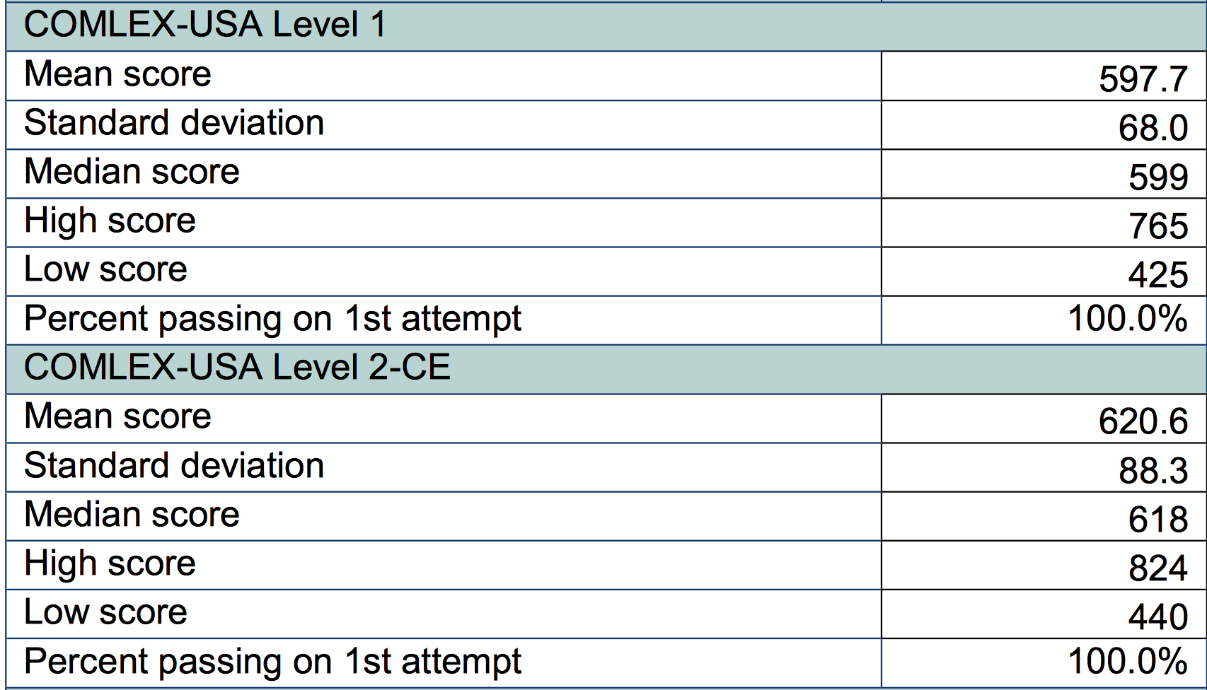
Preparing for Orthopedics
Starts during your 1st year of medical school
Anatomy, Anatomy, Anatomy
GPA is important!
Class rank is important!
Board Scores:
USMLE still controversial
COMLEX 1 > 600 minimum (Ideally 650+)
COMLEX 2 > 620
COMLEX PE: Pass 1st attempt

Slide 27
Build Your Resume
The information you input in ERAS is only what you have completed in MEDICAL SCHOOL!
Research
Preferably orthopedics related but not a requirement
Organizations
Try to have at least 1 leadership position…the more the better
Volunteer Work
Not emphasized a lot during interviews but it will hurt you if you don’t have any
Paid employment
Awards, Honor Societies, Scholarships

Slide 28
3rd Year Elective
Start learning orthopedics
Register for an account @ Orthobullets.com
Register with White Coat Coaching
Register with VuMedi
Books:
Netter’s Concise Orthopedic Anatomy
Handbook of Fractures
Surgical Exposures in Orthopedics
Orthopedic Surgery Clerkship: A Quick Reference Guide for Senior Medical Students
Phone Apps:
Orthobullets
AO

Slide 29
Letters of Recommendations:
Usually Maximum of 4 Letters Accepted
2-3 Orthopedic Letters
Min. 1 LOR must be from someone high up (Dept. Chair, DIO, Program Director etc.)
1-2 LOR from other specialties
Does NOT have to be surgical
GET THEM EARLY!!
Do not expect to get letters on auditions→ Possible, but very difficult
AAOS http://www.aoassn.org/aoaimis/AOANEW/Residents/Standardized_Letter_of_Recommendation/AOANEW/Residents/Standardized_Letter_of_Recommendation_Form.aspx?hkey=b2e7dd53-33d8-4e26-944e-48c664244905

Slide 30
Scheduling Audition Rotations
START EARLY!!! (i.e. January of 3rd yr)
2 week vs. 4 week
WHEN DO THEY INTERVIEW??
Do your homework!
Board score/GPA requirements
VSAS vs. Direct Emailing
Does the residency accept non-rotators?
Is location a factor for you?
Large vs. Small program?
ACGME vs. AOA vs. Dual Accreditation
Competitiveness of program
AFFILIATION AGREEMENTS

Slide 31
Shining on Your Orthopedic Auditions
Make sure you take COMLEX Level 2 prior to auditions!!
Address all the residents as Dr.____
Be on Time!! (I.e. if you are supposed to be there at 4:30am that means you need to be there at 4:15am!)
Be available to help, but do not pester the residents
Carry Supplies: Trauma shears, tape, xeroform, 4x4, notebook, PENS
Reading up on cases→ Much harder than you think
Be alert and attentive to everything you are involved with!
Listen to what the patient is saying even if you are just observing
Share call equally amongst other students
Help other students
Don’t ask to leave early, offer to stay late!!

Slide 32
Personal Statement
~1 page
Make it interesting!
Personal experience you encountered
Avoid clichés & quotes
List your RELEVANT accomplishments but do NOT rehash your application
Why are you PASSIONATE about _____?
Why is ____ a good fit for you?
What are your positive qualities?
How can you contribute to the field?
Close with goals of residency & beyond

Slide 33
OR Etiquette
Be the first one in the room
Text the resident when patient arrives to room and when intubated
Introduce yourself to Circulating nurse and Scrub tech
Write your name on board!!
Get your gloves, gown, hood and resident’s attire as well
A word about glove size…
Help transfer patient to bed
Strap patient to bed, (place xenodynes if using)
Find out if a bump is being used, if a tourniquet is being used
Offer to hold a limb for sterile prep (make sure you have sterile gloves)
Help drape if OR staff is ok with it
***If you don’t know something, or don’t know where something is don’t be afraid to ask***

Slide 34
Interview Practice
75 y F s/p GLF at home.
Complains of R Hip pain
Diagnosis?
Classification?
Treatment plan?

Slide 35
Interview Practice
A/P Pelvis of a skeletally mature individual demonstrating a R basicervical femoral neck fracture, completely displaced with varus angulation
Garden Classification:
Type I→ Partial fracture valgus impaction
Type II→ Complete fracture; Non-displaced
Type III→ Complete fracture; Partial Displacement
Type IV→ Complete fracture with complete displacement
Treatment:
Type I + II: Cannulated hip screws vs. DHS
Type III+IV: Hemiarthroplasty vs. THA

