Slide 1
Foramina of skull

Slide 2
Cranial base
spine of the sphenoid
Petrous part of the temporal bone
mandibular fossae
occipital bone
occipital condyles
Jugular foramen
Carotid canal
Stylomastoid foramen

Slide 3
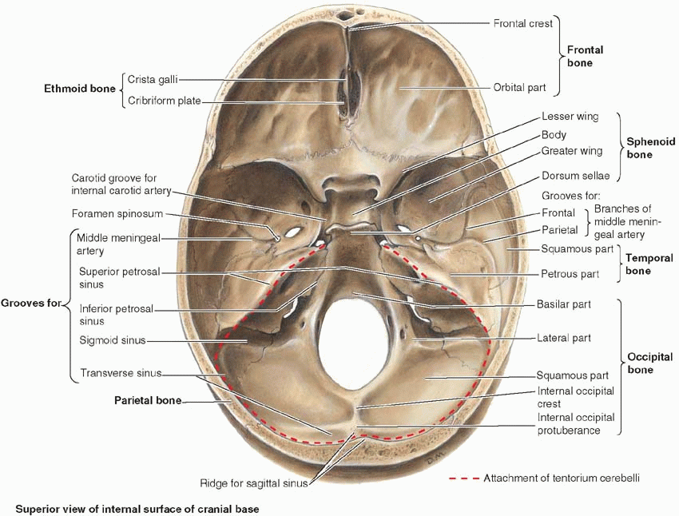

Slide 4
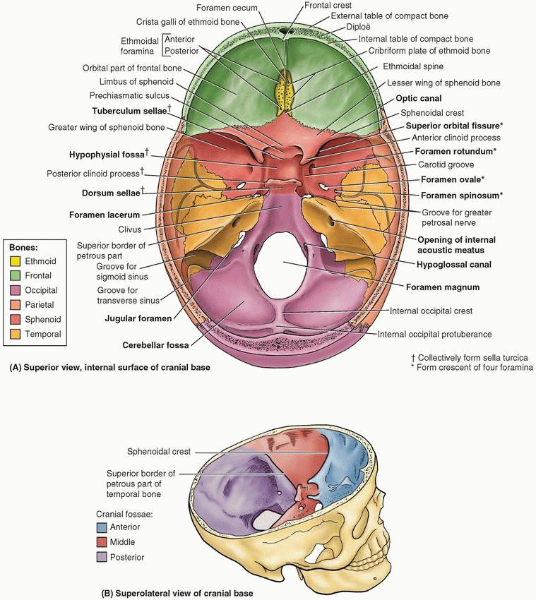

Slide 5
Internal Features of Base of Skull
Divided into anterior, middle, and posterior cranial fossae
Anterior cranial fossa
Contains frontal lobe of brain
Formed by frontal bone anteriorly, ethmoid bone medially, and lesser wing of sphenoid posteriorly
Features
Frontal crest—midline bony extension of frontal bone
Foramen cecum—foramen at base of frontal crest
Crista galli—Midline ridge of bone from ethmoid posterior to foramen cecum
Cribriform plate—Thin, sieve-like plate of bone on either side of crista galli, which transmits olfactory nerves from nasal cavity to olfactory bulbs

Slide 6
Middle cranial fossa
Contains temporal lobe, hypothalamus, and pituitary gland
Formed by greater wing and body of sphenoid, petrous temporal bone, lesser wing sphenoid
Features
Sella turcica—central depression in body of sphenoid for pituitary gland
Tuberculum sellae—Swelling anterior to sella turcica
Dorsum sellae—crest on body of sphenoid posterior to sella turcica
Anterior clinoid processes—medial projections of lesser wings of sphenoid bones
Posterior clinoid processes—swelling at either end of dorsum sellae
Foramen lacerum (one on each side)—jagged opening closed by plate of cartilage in life, transmits nothing

Slide 7
Posterior cranial fossa
Contains cerebellum, pons, and medulla oblongata
Composed of largely of occipital bone, body of sphenoid, petrous, and mastoid parts of temporal bone
Features
Foramen magnum—transmits spinal cord
Internal occipital crest—divides posterior fossa into two lateral cerebellar fossae
Grooves for transverse and sigmoid dural venous sinuses
Jugular foramen—transmits sigmoid sinus (internal jugular vein, and several cranial nerves
Internal acoustic meatus—anterior and superior to jugular foramen, transmits facial and vestibulocochlear nerves (CN VII and CN VIII)
Hypoglossal canal—anterolateral and superior to foramen magnum, transmits hypoglossal nerve (CN

Slide 8
Opening | Bone | Structures Transmitted
Optic canal | Lesser wing sphenoid | Optic nerve Ophthalmic artery Sympathetic plexus
Superior orbital fissure | Greater and lesser wings sphenoid | Lacrimal nerve (V₁) Frontal nerve (V₁) Trochlear nerve (IV) Oculomotor nerve (III) Abducent nerve (VI) Nasociliary nerve (V₁) Superior ophthalmic vein
Inferior orbital fissure | Between zygomatic and greater wing of sphenoid | Infraorbital vein Infraorbital artery Infraorbital nerve

Slide 9
Foramen spinosum | Greater wing of sphenoid | Middle meningeal artery and vein
Foramen rotundum | Greater wing of sphenoid | Maxillary division trigeminal nerve (V3)
Foramen ovale | Greater wing of sphenoid | Mandibular division trigeminal nerve Lesser petrosal nerve
Foramen lacerum | Between petrous part temporal bone and sphenoid bone | artery of pterygoid canal, the nerve of pterygoid canal and some venous drainage also pass through the foramen lacerum
Foramen magnum | Occipital bone | Medulla oblongata Vertebral artery Meninges Spinal roots of accessory nerve
Hypoglossal canal | Occipital bone | Hypoglossal nerve (XII)
Jugular foramen | Between petrous part temporal bone and occipital bone | Glossopharyngeal nerve (IX) Vagus nerve (X) Accessory nerve (XI) Inferior petrosal sinus Sigmoid sinus Posterior meningeal artery
Internal acoustic meatus | Petrous part temporal bone | Vestibulocochlear nerve Facial nerve Labyrinthine

