Slide 1
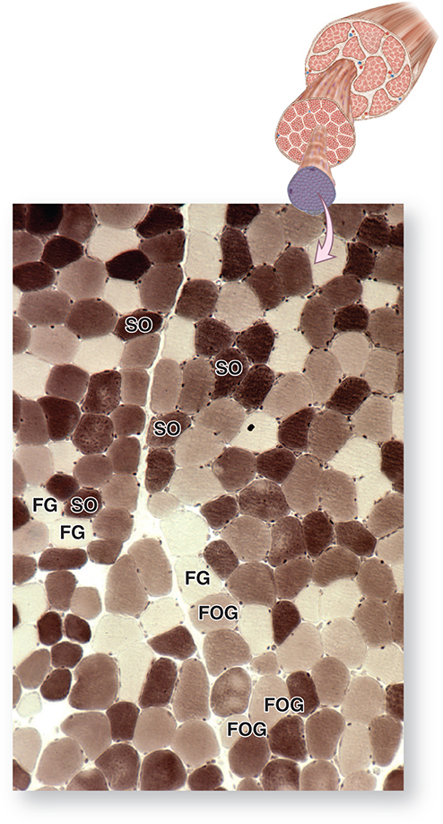
Skeletal Muscle Fiber Types
Slow oxidative (type I) muscle fibers are adapted for slow contractions over long periods without fatigue.
Fast glycolytic (type IIb) fibers are specialized for rapid, short-term contraction.
Fast oxidative-glycolytic (type IIa) fibers have a combination of the physiological and histological features of the other two fibers.
Slow oxidative (SO) or type I fibers
Fast oxidative-glycolytic (FOG) or type IIa
Fast glycolytic (FG) or type IIb
Cross section of a skeletal muscle stained histochemically for myosin ATPase
Notes:
Cross section of a skeletal muscle stained histochemically for myosin ATPase at acidic pH, which reveals activity of the “slow” ATPase and shows the distribution of the three main fiber types. Slow oxidative (SO) or type I fibers have high levels of acidic ATPase activity and stain the darkest. Fast glycolytic (FG) or type IIb fibers stain the lightest. Fast oxidative-glycolytic (FOG) or type IIa fibers are intermediate between the other two types (X40). ATPase histochemistry of unfixed, cryostat section, pH 4.2.

Slide 2
