Slide 1
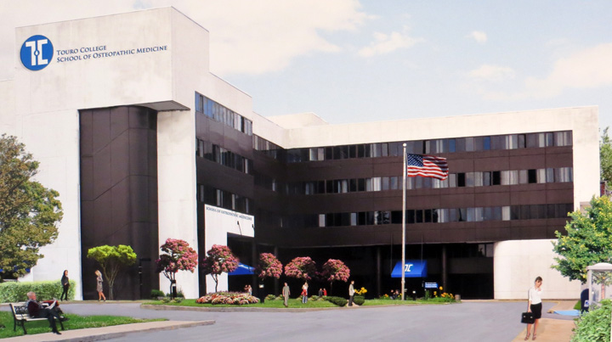
Touro College of Osteopathic Medicine Middletown, NY
Assessments, Academic Support and Student Surveys
Graduation and MS-DO Matriculation Requirements
Stephen Jones, PhD
Preclinical Dean

Slide 2
Lets talk about…
The assessment/exam schedule
The testing process
Software used for the exam, your own personal computer
Testing policy
Faculty analysis of test
Grade calculations and exam report
Response to academic problems

Slide 3
The Flipped Classroom Curriculum at TouroCOM-the three pillars
Students discover content independently and at their own pace outside of the classroom
Short Videos, lecture slide sets, assigned readings, vetted on-line material
Apply and anchor the material using lab/classroom science based, compelling and patient centered exercises.
Gross anatomy lab, dynamic classroom experiences, clinical scenerios, patient simulation
Assessment and feedback
Laboratory practicals, in class “clickers,” computerized exams that track competencies

Slide 4
Course Documentation Book: The Who, What, When, Where of the TouroCOM Curriculum
Year one overview
Semester 1 and 2 courses
General Weekly Schedule
Exams, labs, discussion sessions
Academic policies (see Student Handbbok as well for comprehensive policy list)
Course Syllabi
Exam and lab practical dates
Includes Hour by Hour Course Objectives

Slide 5
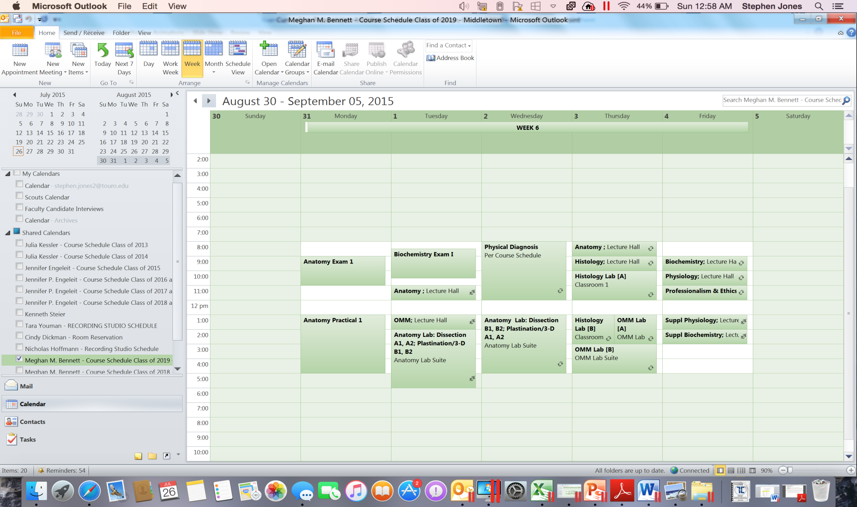
Exam Dates are found on the posted calendar and your course syllabus!

Slide 6
Note: be aware of schedule changes when you have non-Monday exams.

Slide 7
Testing: a Multistep Process
Harlem & Middle-town faculties collaborate to construct exam based upon LO’s.
Exam is downloaded by students & opened by pw
Exam administration
Exam is reviewed by faculty
1 week after test administration grades are released

Slide 8
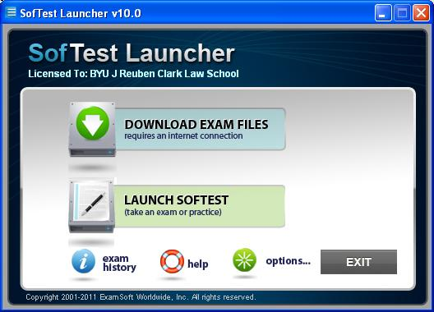
Students use a program called SofTest to securely take exams on their own personal computers.
Hence, the laptop specifications published in the booklist and course documentation handbook.
SofTest Student Orientation will be held within the next 2 weeks. Student attendance is mandatory.

Slide 9
Computer requirements
in order to run Examsoft
are in your Course Doc
book.

Slide 10
Touro College of Osteopathic Medicine Policy for Testing (Highlights)
The exam is downloaded ahead of time and activated with a password.
Students must check in for their exam no less than 15 minutes before scheduled start and report directly to assigned seat.
A security screen cover, provided by the student, must be affixed to the computer during the exam.
Exam rooms are cleared of all students and belongings 45 minutes before the start; no food or drinks are permitted when admitted back into the room.
Students who present more than 15 minutes late will not be permitted to sit for the exam and must report to the Dean of Student Affairs or the Preclinical Dean. A 10% penalty may be assessed.
Each exam seating will be limited to a 2-hour duration.
No one may leave the room during the exam, except to close and exit the exam.

Slide 11
Testing: a Multistep Process
Harlem & Middle-town faculties collaborate to construct exam based upon LO’s.
Exam is downloaded by students & opened by pw
Exam administration
Exam is reviewed by faculty
1 week after test administration grades are released

Slide 12
Exam Grading Process – Review Stage
Item Analysis – Statistics on Each Question

Slide 13
Exam Grading Process – Review Stage
Item Analysis – Statistics on Each Question
Exploring the number of students who selected each answer choice allows us to better address any confusion.
How well did the question differentiate between the high and low performing students?
Looking at the overall % of the class that answered question correctly allows us to pinpoint confusion
Comparing the % of top scoring versus poor performing students that answered the question correctly allows us to determine if questions are measuring overall preparation and knowledge.

Slide 14
Exam Grading Process – Review Stage
Students can comment on the exam and raise concerns on specific questions.

Slide 15
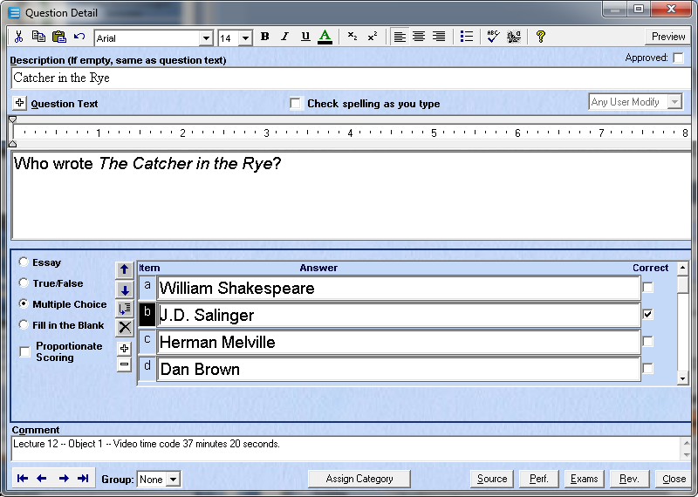
Faculty Test the Learning Objectives!
Professor Links Exam Question to Video Source
Exam Questions are linked to the learning objectives.
Students Receive Video Source on their Score Sheet
Confidential product from Touro College of Osteopathic Medicine, New York

Slide 16
Overview of Exam Grading

Slide 17
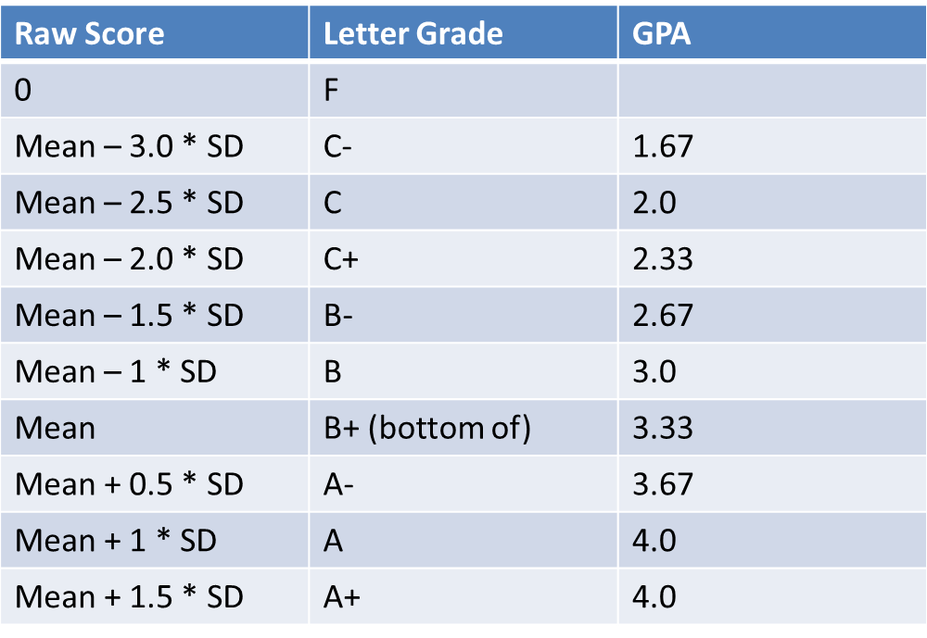
Overview of Exam Grading
Final Grading is Based Upon a Class Curve (“B+ Curve”)

Slide 18
Overview of Exam Grading
The curve: you are better off with it, than without it.
Courses represented:
Anatomy I & II
Biochemistry
Medical Genetics
Histology
Immunology
Neuroanatomy
Physiology I & II
Bottom line: there are fewer 3.5’s without the curve than with it.

Slide 19
Grade Reporting

Slide 20
Grade Reporting
Grade Distribution Graph

Slide 21
Based upon exam grades and objective mapping, students can identify and target their weaknesses
Professor Links Exam Question to Video Source
Exam questions are linked to the learning objectives.
Students Receive Video Source on their Score Sheet
Confidential product from Touro College of Osteopathic Medicine, New York

Slide 22
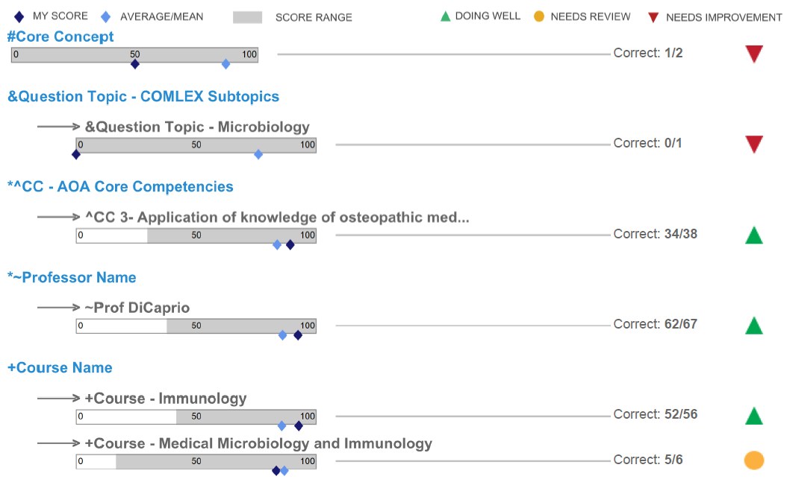
Grade Reporting
ExamSoft Score Reports give students feedback on categorized questions

Slide 23
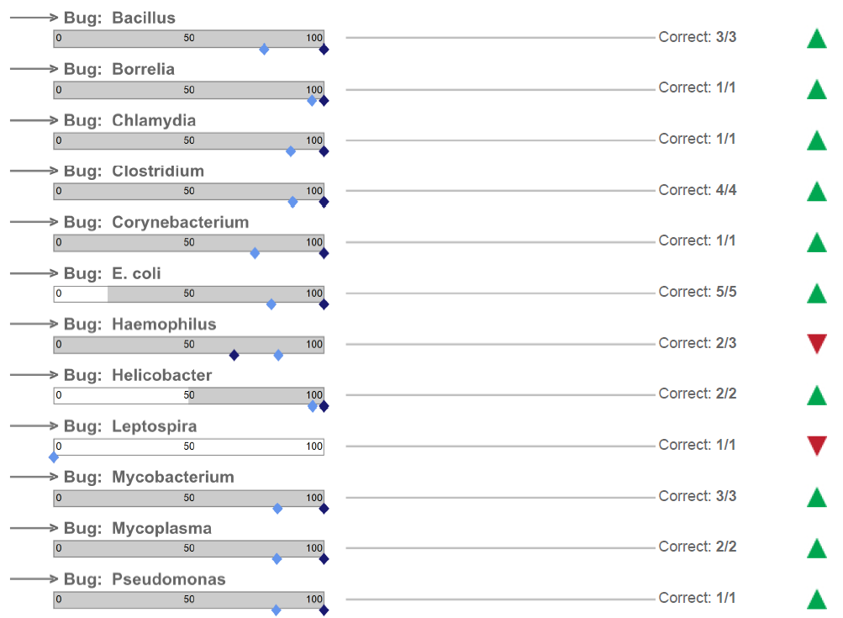
Grade Reporting
ExamSoft Score Reports Give Students Feedback on Categorized Questions

Slide 24
Grade Reporting
Roster of Student Grades

Slide 25
Grade Reporting
Student Performance on Core Concept and Majority Correct Questions

Slide 26
Faculty and administrative response to academically at risk students

Slide 27
Low/Failing performance on any one exam will trigger a faculty response.
Exam Report

Slide 28
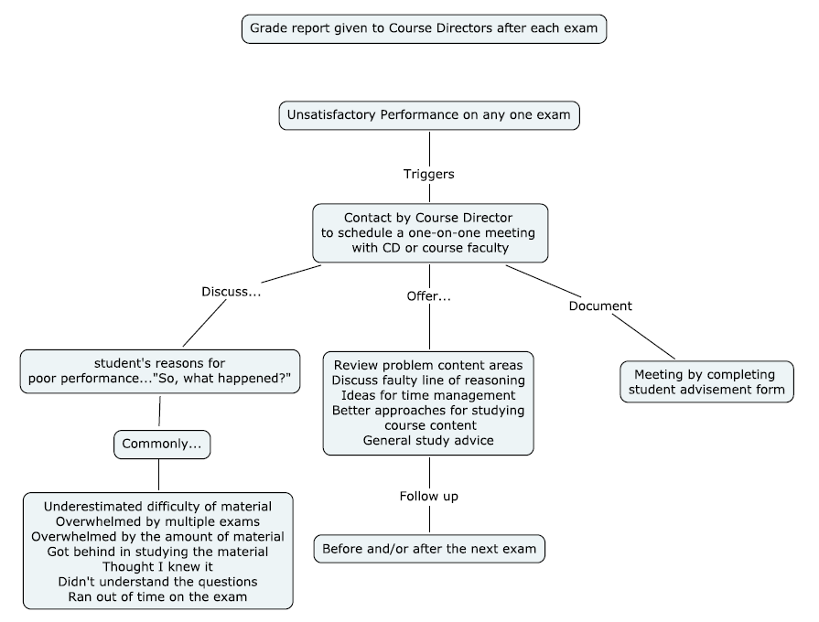

Slide 29
Chronic poor performance will not only be obvious to the Course Director but will trigger an administrative response as well.
Chronic poor performance
Course Director
Administration
Quarterly Grade Report
Early Warning System
Academic Advisor
Preclinical Dean

Slide 30
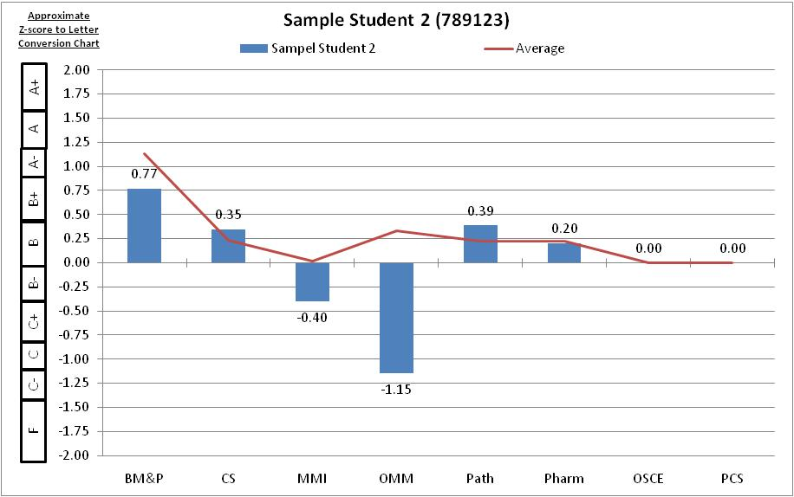
A comprehensive grade report is created three times per semester, and distributed to academic advisors, who respond accordingly.

Slide 31
The Early Warning System in the office of preclinical dean is based on exam performance and trending.

Slide 32
The Early Warning System identifies students at risk or whose performance is declining. It is based upon:
Performance on high-stake exams
Predicted final course grades
The Goal:
Contact students of concern as early as possible to ensure they
receive all the resources they need to be successful.

Slide 33
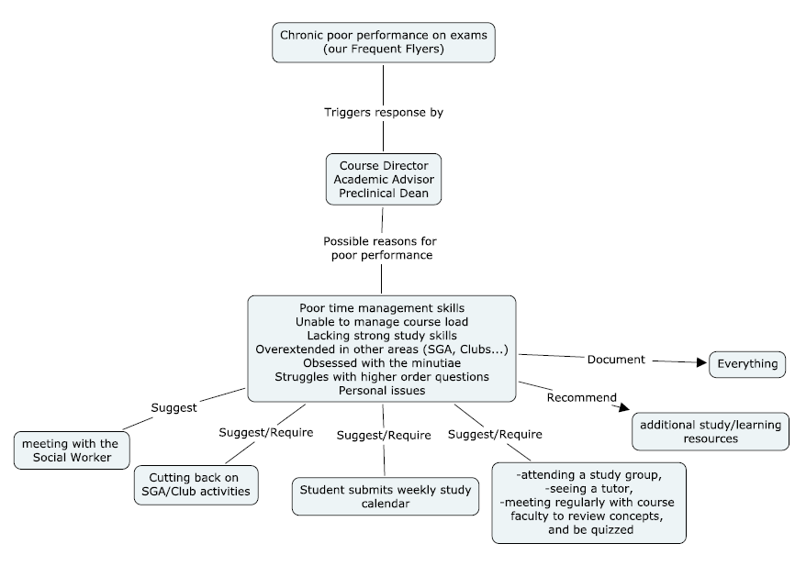
Follow-Up

Slide 34
REACH Program
The REACH program is an early intervention effort which combines the development of strong study/learning skills with application to relevant basic and clinical science content.
The goals of the REACH Program are to:
provide an opportunity for students to strengthen their understanding of pre-clinical course content through faculty facilitated peer-peer discussion and teaching,
improve lifelong learning skills through the introduction and application of proven successful learning strategies and skills,
to improve learning outcomes not just in a single course, but throughout a student’s medical training.
Attendance of REACH is mandatory for all MS students.

Slide 35
Learning Resources for All Students
There are a number of online sites at the medical school/college level that provide valuable study tips (study techniques, note taking, memorization, etc).
Students should review some of these to help them optimize their school performance. Some valuable resources to check out:
http://sgh.org.sa/Portals/0/Articles/How%20to%20Succeed%20at%20Medical%20School%20-%20An%20essential%20guide%20to%20learning.pdf
http://som.unm.edu/ume/oars/strategic/index.html
http://library.lmunet.edu/medlib/osteopathic-medicine
http://meded.ucsd.edu/index.cfm/ugme/oess/study_skills_and_exam_strategies/faqs_on_studying_and_exams/
http://www.ttuhsc.edu/som/success/

Slide 36
Student Surveys
The worst thing you can do as a student is to be unhappy about some component of the curriculum and not share your concern with the course director or faculty.
Student surveys of courses are reviewed by faculty, administration and the Curriculum Committee.
As always, make your comments constructive and professional. Many a valuable thought is lost to angry or unprofessional language.
Participate!

Slide 37
Graduation and MS to DO Matriculation Requirements
Requirements for direct admission into the TouroCOM-NY D.O. program are as follows:
Within the top 35 students of the class
M.S. Program completion with a cumulative GPA of 3.450/4.0 and a grade of Pass on the Comprehensive Examination.
Demonstrated professionalism and conduct becoming of a physician throughout the program, and otherwise adherence to the Admission deadlines and requirements covered in Touro College of Osteopathic Medicine College Handbook.
Conduct unbecoming of a physician will disqualify you from DO admissions, regardless of the 3.450.
MS to DO direct matriculation students are admitted to the Middletown DO program.

Slide 38
Graduation and MS to DO Matriculation Requirements
Requirements for the award of the Master’s Degree are as follows:
Program completion with a final cumulative GPA of 3.0/4.0 and a grade of Pass on the Comprehensive Examination.

Slide 39
DO Options
Students should recognize that completion of the MS program in and of itself is an accomplishment that will open doors to the next phase of your career.
Many of our graduates who don’t reach the 3.5 go on to attend medical school because of this program.

Slide 40
DO Options
All students should maximize their options.
If your MCAT has limited your options up to this point you should work towards re-taking it.
Although not required for direct matriculation from the MS program into the TouroCOM Middletown DO program (with 3.450 and COMP), students are always welcome to enter the ACCOMAS application cycle.
Should you decide to apply directly to the D.O. Program at Touro College of Osteopathic Medicine, Middletown Campus, through the standard application pathway (ACCOMAS), you must do so by submitting a new AACOMAS application within the application cycle timeframe for consideration. All published admission requirements will apply.
Please consult with the DO Admissions Department for any further questions regarding this process.

