Slide 1
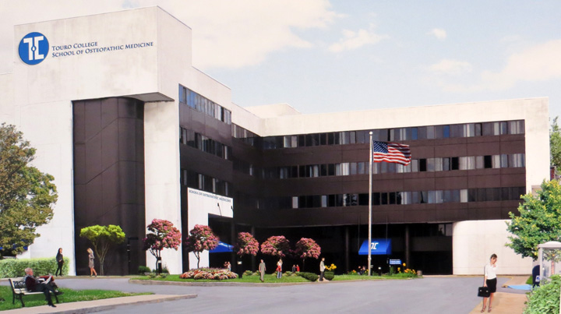
Touro College of Osteopathic Medicine Middletown, NY
Introduction to faculty and the MS curriculumm
Stephen Jones, PhD
Preclinical Dean and MS Program Director

Slide 2
Your Administration
Stephen Jones, PhD
Program Director
Pearl Myers, MD
Assistant Director
Kristen Boland
Program Administrator

Slide 3
Lets talk about…
MS Curriculum, weekly schedule
Flipped classroom
iClicker policies
Using the course syllabus to be prepared
Accessing videos and lecture slide sets
Interactive sessions and Iclicker Policies
Policy points on schedules

Slide 4
Masters Program - 1st semester
Courses | Course Number | Credits
Clinical Anatomy and Embryology I | CBE 530 | 7
Biochemistry I | CBE 500 | 4
Physiology I | CBE 550 | 4
Histology I/Cell Biology I | CBE 510 | 5
Law and Ethics in Medicine | CBE 620 | 1
 |  | 21
Masters Program - 2nd semester
Courses | Course Number | Credits
Clinical Anatomy and Embryology II | CBE 535 | 3
Medical Genetics | CBE 501 | 3
Physiology II | CBE 551 | 3
Neuroanatomy | CBE 520 | 4
Microbiology and Immunology | CBE 600 | 6
Community Service | HS 668 | 1
Health and Human Behavior | CBE 580 | 2
 |  | 22

Slide 5
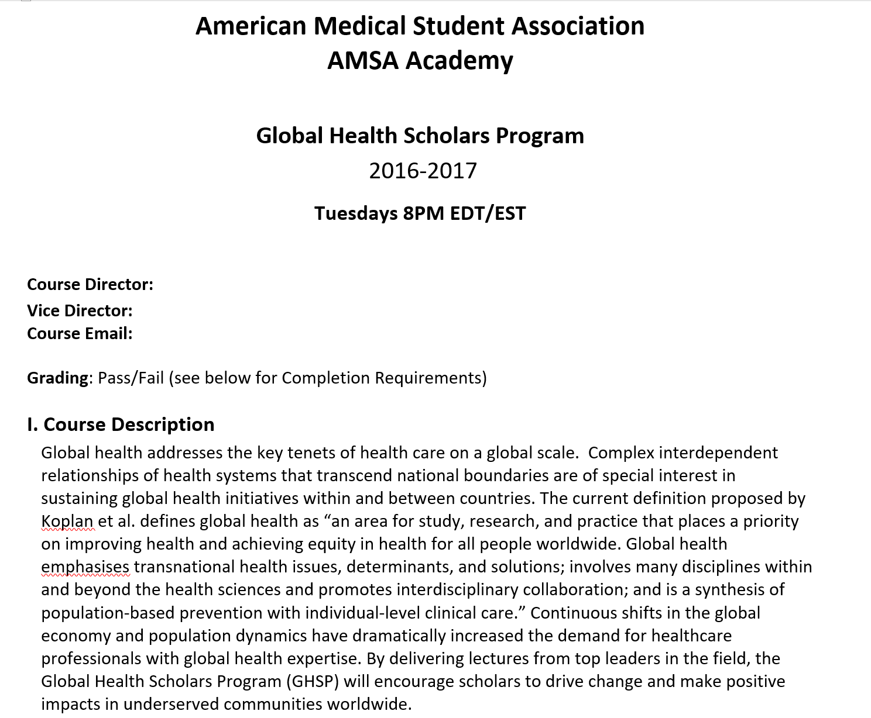

Slide 7
Weekly Schedule, Semester 1
Note: the schedule does change from week to week to
accommodate exams, Jewish holidays, etc. Therefore….

Slide 8
Important notices:
Supplemental sessions are required activities, attendance is taken.
REACH program is a study skills building program. 1X week for about 4 weeks. Attendance is required.
You must refer to the posted Yr 1 calendar for your daily schedule!

Slide 9
Other important notices….
You must check your TouroCOM email everyday for notices and updates from admin and course faculty!!!!
Notices will only be sent to Touro email addresses.
Admin and faculty are not responsible for notices that you don’t receive because you don’t check your Touro email.

Slide 10
Lets talk about…
MS Curriculum, weekly schedule
Flipped classroom
iClicker policies
Using the course syllabus to be prepared
Accessing videos and lecture slide sets
Interactive sessions and Iclicker Policies
Policy points on schedules

Slide 11
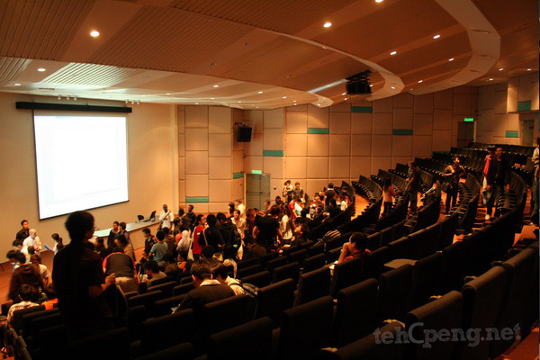
In the beginning, there were live lectures….

Slide 12
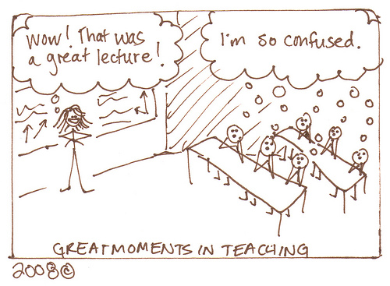

Slide 13
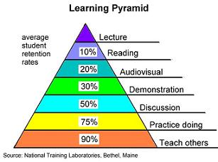

Slide 14
Classes with no lecture halls
Academic Medicine
Medical Education Reimagined: A Call to Action
Charles G Prober MD, Salman Kahn
Acad Med, Vol 88:10, October 2013
MS students are programmed to memorize, despite sometimes missing the relevance of the information if it is presented without a clinical context.
Current system (lecture based) of medical education is inflexible and is not sensitive to the skills and aspirations of individual learners.
Propose flipping the classroom

Slide 15
Classes with no lecture halls
What is a flipped classroom?

Slide 16
Classes with no lecture halls
What the flipped classroom is NOT…
Just videos
About replacing teachers with videos
An online/correspondence class
Students working without direction and feedback from faculty
Students working in isolation
Students spending the entire class online

Slide 17
Classes with no lecture halls
Rather, the flipped classroom…
Increase student interaction with faculty
Increases student responsibility
Engages all of those students who want to be engaged.
A class where all students are invested in their learning
Places emphasis more on application of principles than delivery of content

Slide 18
Classes with no lecture halls
Essential Components of any Flipped Classroom:
Provide an opportunity for students to gain first exposure prior to class.
Provide an incentive for students to prepare for
Provide a mechanism to assess student understanding
Provide in class activities that focus on higher level congnitive activities
Source: https://cft.vanderbilt.edu/guides-sub-pages/flipping-the-classroom/

Slide 19
The Flipped Classroom Curriculum at TouroCOM-the three pillars
Students discover content independently and at their own pace outside of the classroom
Short Videos, lecture slide sets, assigned readings, vetted on-line material
Apply and anchor the material using lab/classroom science based, compelling and patient centered exercises.
Gross anatomy lab, dynamic classroom experiences, clinical scenerios, patient simulation
Assessment and feedback
Laboratory practicals, in class “clickers,” computerized exams that track competencies

Slide 20
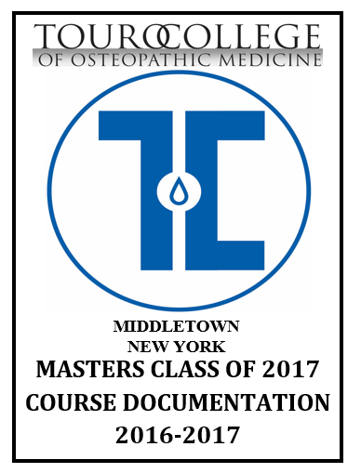
Course Documentation Book: The Who, What, When, Where of the TouroCOM Curriculum
MS Program overview
Semester 1 and 2 courses
General Weekly Schedule
Exams, labs, discussion sessions
Academic policies (see Student Handbbok as well for comprehensive policy list)
Course Syllabi
  Exam dates
  Includes Hour by Hour Course Objectives

Slide 21
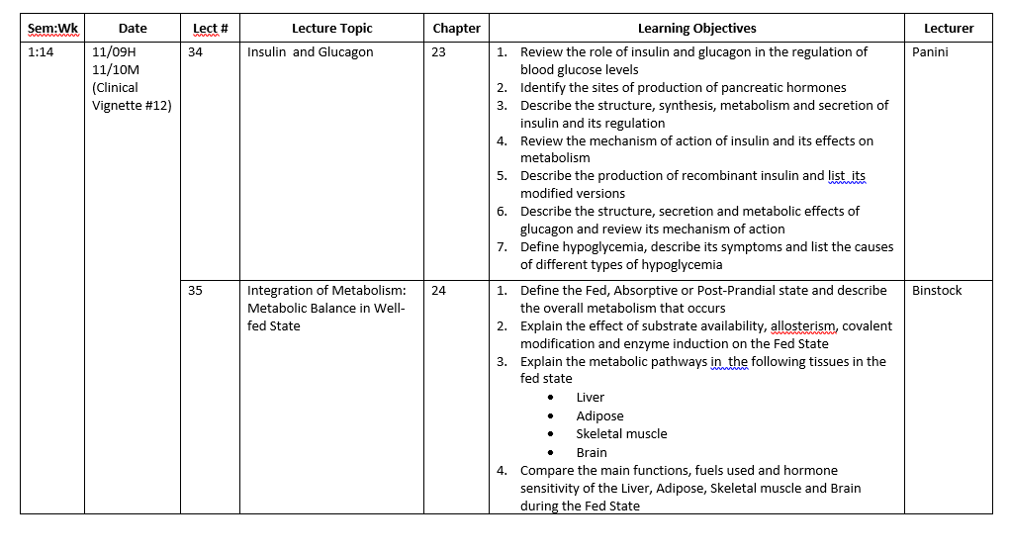
Excerpt of Syllabus Schedule and Lecture
Objectives from the
Course Documentation Book
Biochemistry
Confidential product from Touro College of Osteopathic Medicine, New York

Slide 22
About those learning objectives…
Use the learning objectives! They are your road map for academic success.
Not only in your syllabus, but also within the first few slides of every one of your lectures.
Exam questions are mapped to the learning objectives.
More on how to use LO’s during tomorrow’s course overviews.

Slide 23
Questions?

Slide 24
Excerpt of Syllabus Schedule and Lecture
Objectives from the
Course Documentation Book
Biochemistry
Confidential product from Touro College of Osteopathic Medicine, New York

Slide 25
Now what?
It’s time to find the video, required reading, or posted assignment.
Log in to Blackboard with your Touro One ID and password.

Slide 26
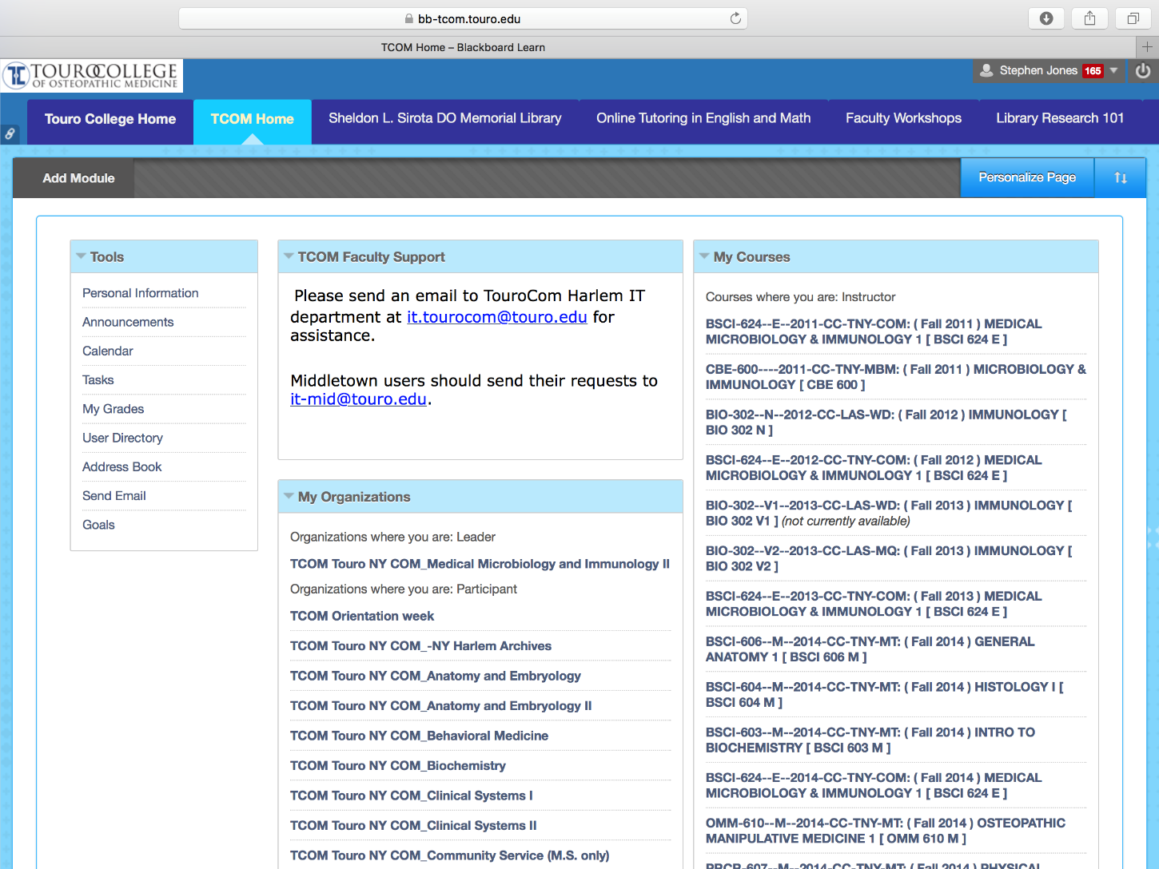

Slide 27
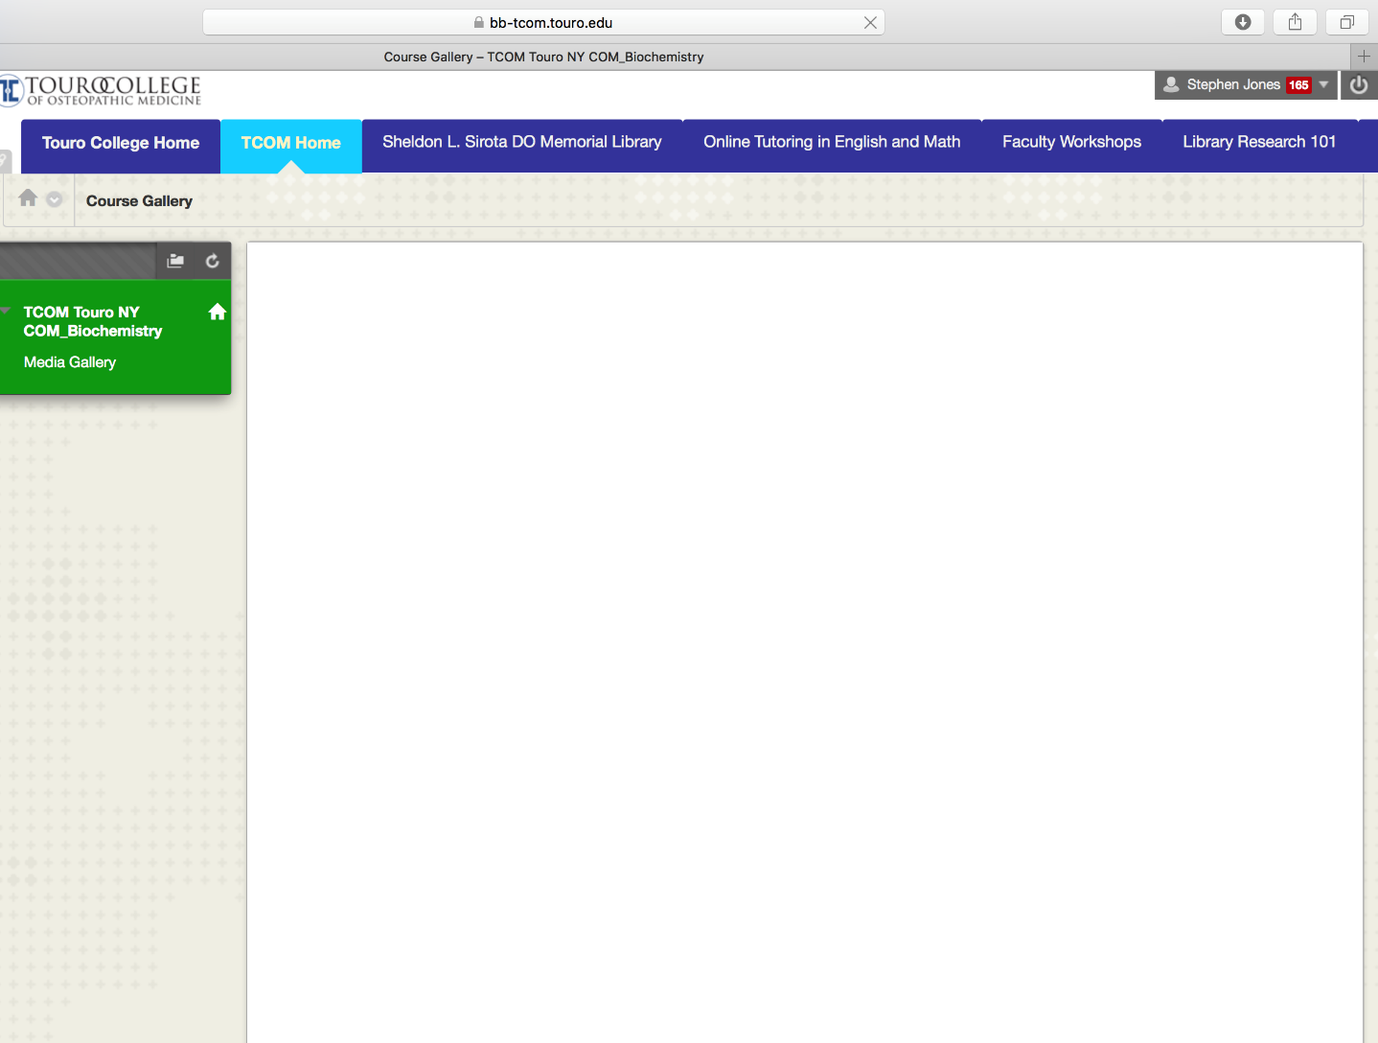

Slide 28
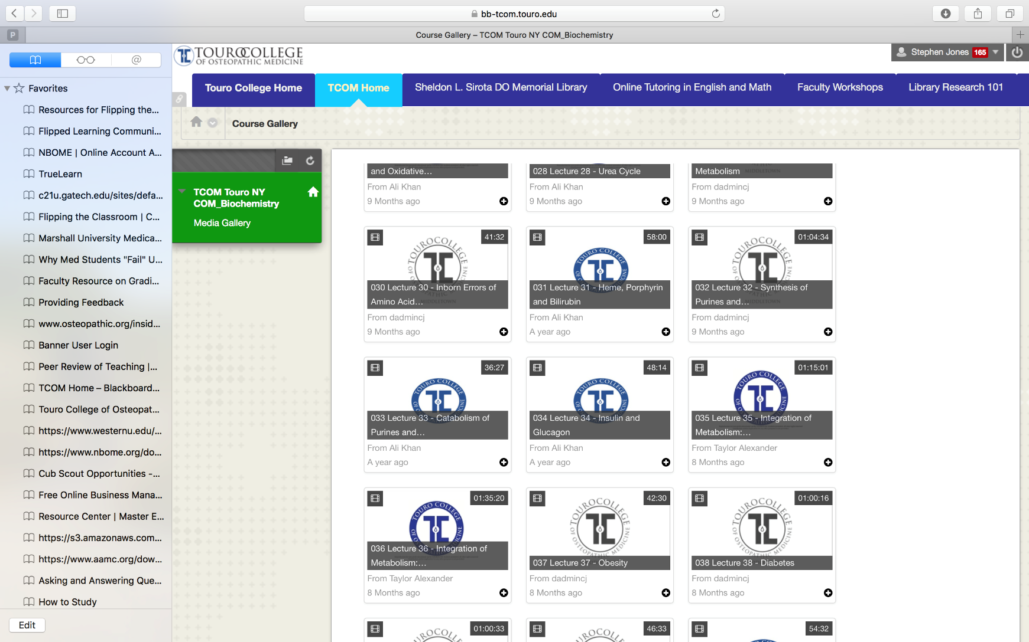

Slide 30
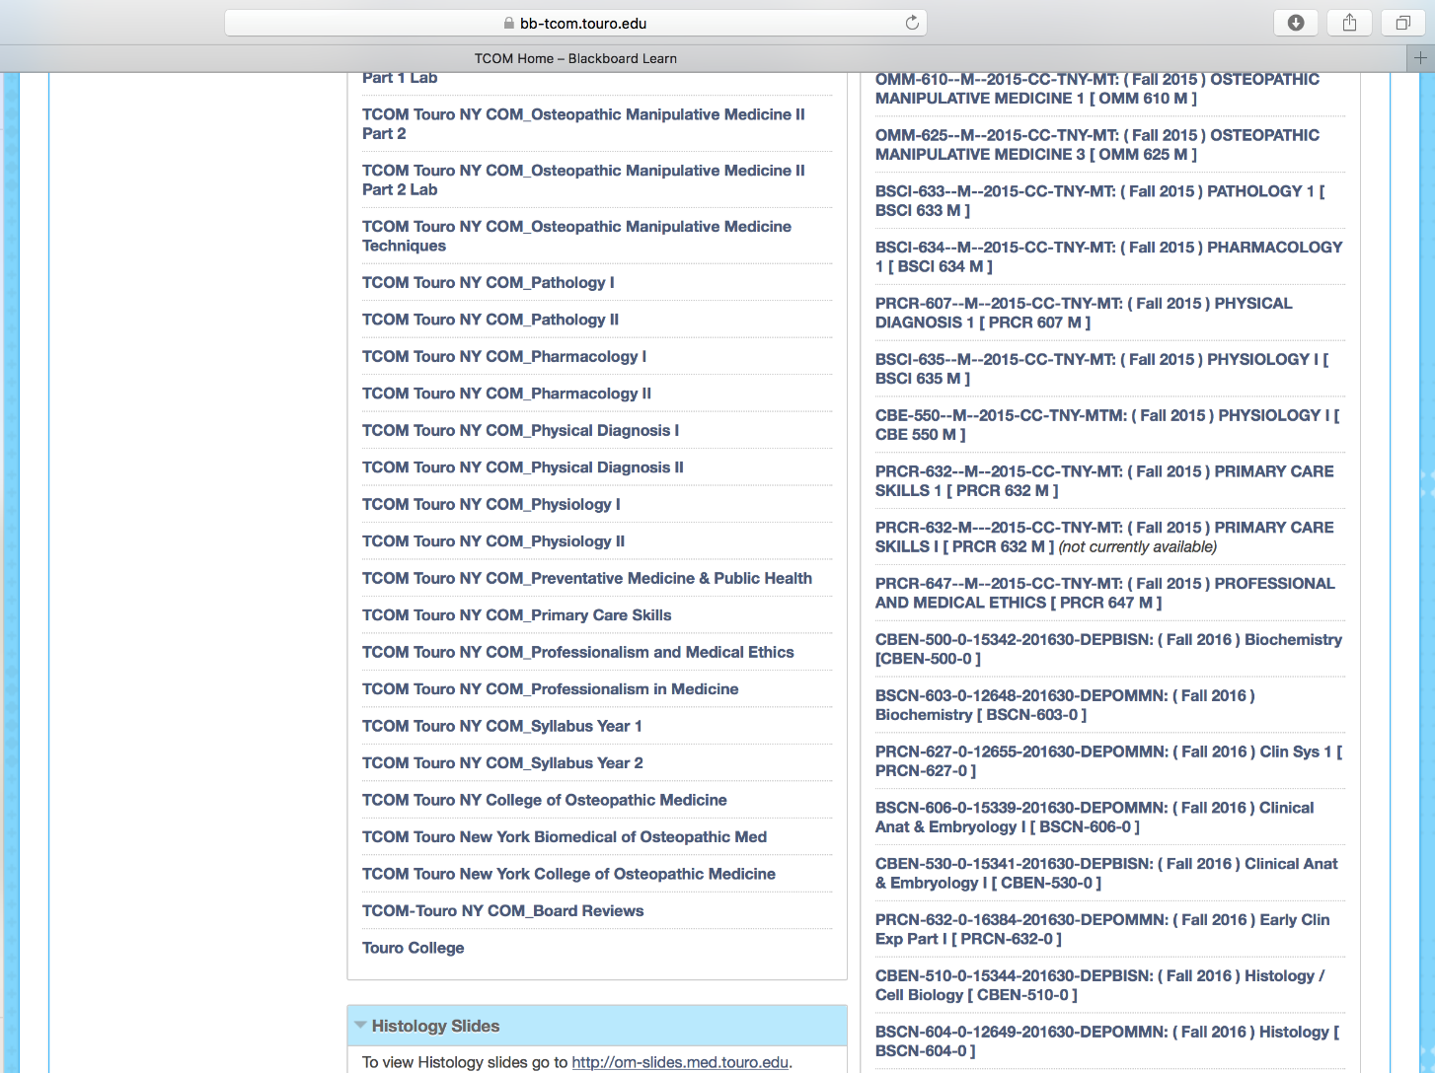

Slide 31
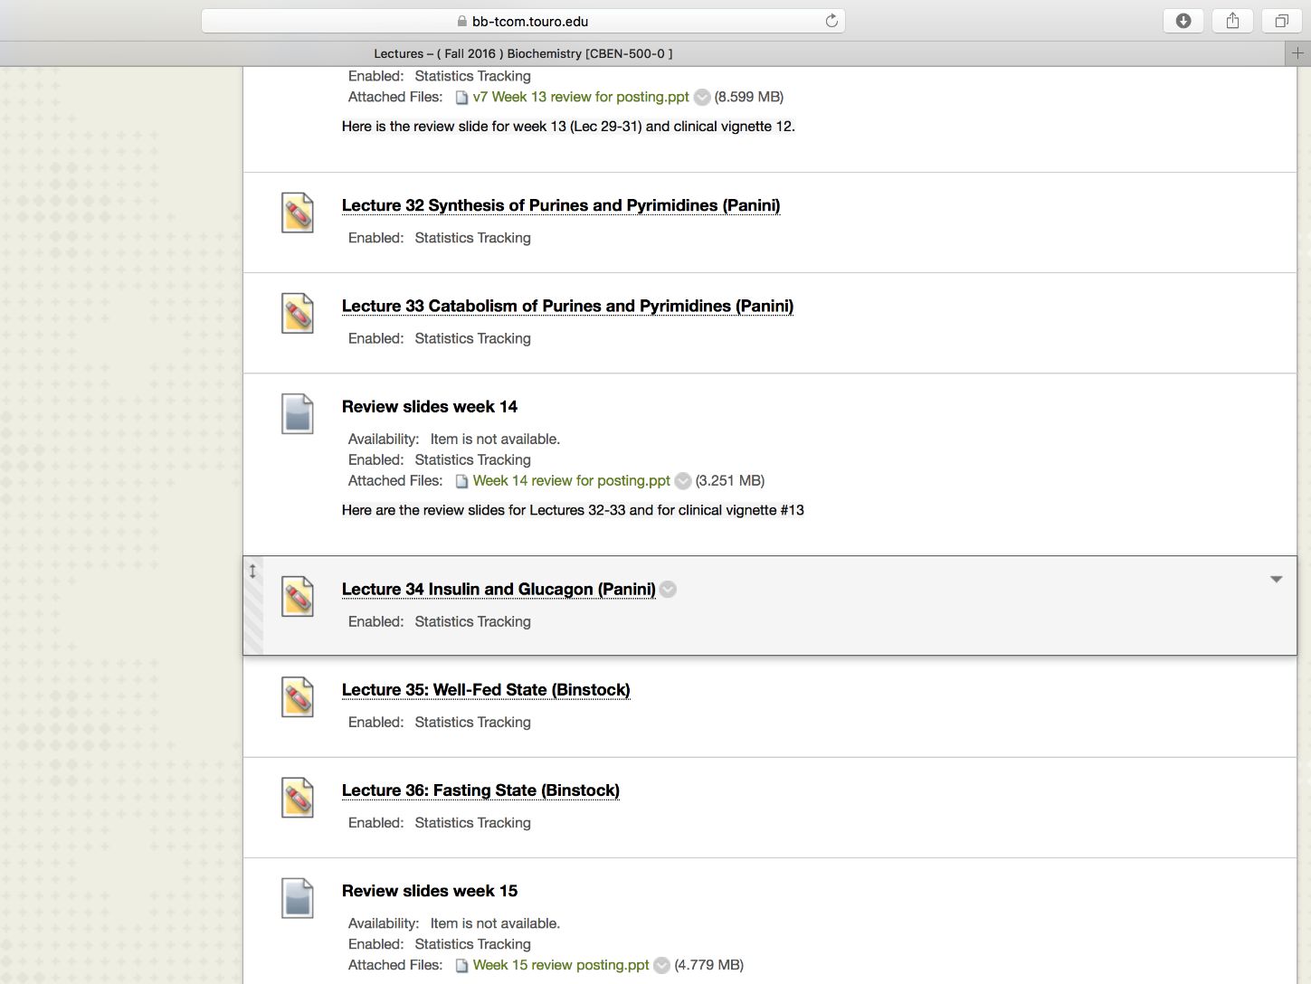

Slide 32
The syllabus. You have to use it.
Biochemistry
Confidential product from Touro College of Osteopathic Medicine, New York

Slide 33
The Flipped Classroom Curriculum at TouroCOM-the three pillars
Students discover content independently and at their own pace outside of the classroom
Short Videos, lecture slide sets, assigned readings, vetted on-line material
Apply and anchor the material using lab/classroom science based, compelling and patient centered exercises.
Gross anatomy lab, dynamic classroom experiences, clinical scenerios, patient simulation
Assessment and feedback
Laboratory practicals, in class “clickers,” computerized exams that track competencies

Slide 34
The Flipped Classroom Model at TouroCOM
Interactive Classroom Experiences
Dynamic Classroom Experiences that Emphasize Application of Key Principles from the assigned lectures.
Different courses structure and run their interactive sessions in
different ways. Course overviews!
Small group session may start with brief content review or
lightning question round that quiz students on the basics
(individual responses usually graded).
Discussion questions are more clinically complex questions
based upon patient presentations. Group effort to answer correctly.
Response given following small group discussion is graded
Each question is followed by a professor led discussion on
any topic with student confusion or difficulty
Refer to course syllabus for grade breakdown,
most courses clicker grade accounts for 10% final grade

Slide 35
Important iClicker Policy Points
(iClicker policy can be found in your Course DOC Book)
Some of your courses/labs are split into A and B discussion (lab) groups. You will not receive credit for attending the alternative groups.
Attendance is required to receive credit for participating in iClicker sessions.
No iClicker, no points. A functioning clicker is your responsibility. Case closed.
The following arguments will not work:
  “My batteries died, here are my answer choices” (as the student hands the faculty members a piece of paper).
  My iClicker stopped working for some reason...here are my choices.
  I chose C, but I it recorded B.
An unexcused absence from a discussion/interactive session will be counted as a missed session and will result in a grade of zero for that session.

Slide 36
Important iClicker Policy Points
(iClicker policy can be found in your Course DOC Book)
Excused absences are only granted by the Dean of Student Affairs. Don’t ask faculty.
Inappropriate use of iClickers is a violation of the student honor code and will result in everyone involved being reported to the Dean of Student Affairs.
This includes giving your clicker to someone else to click for you. Don’t do it. This is the one and only warning.

Slide 37
Important iClicker Policy Points
(iClicker policy can be found in your Course DOC Book)
iClicker Grading
iClicker grades are calculated based upon the percentage of questions answered correctly over the entire semester.
A student may miss one session during the semester, during which an average number of questions are asked, without penalty. Sessions that a student has an excused absence for will not be counted.
Some teaching laboratories’ also use iClickers for interactive sessions. These lab sessions may be graded, however, no lab clicker grades are dropped.
Similarly, there is no dropped iClicker grades in course where the iClicker is used specifically for attendance purposes.

Slide 38
Who to speak with if you have questions or concerns about the course?
The Course Director! He or she wants to hear from you.
Your course/class representatives
  Established with the help of the SGA, these students will regularly report back to the Course Director.
The Department Chair
Program Director, Assistant Director

Slide 39
Some policy points:
The weekly schedule is set by the TouroCOM Middletown Curriculum Committee (in which faculty, students and administration participate) and is the result of many hours of consideration.
Once set the schedule does not change as it involves the schedules of many full time and adjunct faculty, room assignments, and movement of students.

Slide 40
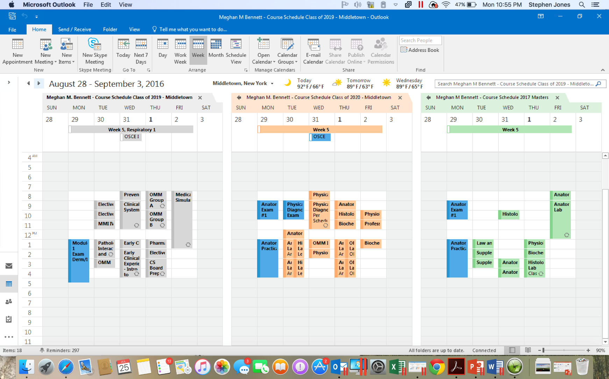

Slide 41
Some policy points:
Which bring to the next point…the exam schedule….
It is coordinated among three programs running in parallel, across two campuses.
It is produced with your best interest and best outcomes as the first priority.
It is set and does not change.

Slide 42
Lets talk about…
TouroCOM faculty
MS Curriculum, weekly schedule
Flipped classroom
iClicker policies
Using the course syllabus to be prepared
Accessing videos and lecture slide sets
Interactive sessions and Iclicker Policies
Policy points on schedules

