Slide 1

Learning Strategies for Medical School Success

Slide 2
What Determines Success in Health Science Education
Student-Faculty Contact
Cooperate with your fellow students
  Learning is collaborative and social, not competitive and isolated
Learn actively
Take the feedback that you receive, analyze it and move ahead.
Time --- time + energy = learning
Recognize/understand your learning preferences

Slide 3
Topics
Time management
Effective note taking
Active reading
Self Regulation/Metacognition
Milking your memory
Why students think they understand, when they dont

Slide 4
Topics
Time management
Effective note taking
Active reading
Self Regulation/Metacognition
Milking your memory
Why students think they understand, when they dont

Slide 5
Where does your time go?
In order to seek improvements, you first need to observe your current habits.
Write down how many hours a week you spend on the following activities.

Slide 6
How many hours a week do you spend…
Attending Class
Working (outside job?)
Sleeping
Personal care
Traveling (to and from class) weekday
Traveling weekend
Studying
Eating
Watching TV
Cleaning apartment/room, doing laundry
Caring for family
Exercise
Attending athletic practice or games
Surfing the net (facebook), videogames, etc
Leisure activities (reading, talking on the phone, etc)
Other (social)

Slide 7
Where does your time go?
On what activities did you spend the most amount of time?
On what activities did you spend the least amount of time?
To what activities would you like to devote more time?
Are you satisfied with the way you spend your time?
What changes would you like to make?
Sources:
Carol Kanar, The Confident Student

Slide 8

We lose a lot of time in unproductive ways…
  Eliminate those time thieves!
Example of time thieves include:
  Procrastination
  External Distractions (noise, music, TV, facebook, etc)
  Internal Distractions (hunger, fatigue, worrying, etc)
  Over scheduling
  Poor organization
  Our peers! Sorry, but it’s true. Stress spreads like wildfire and before you know it your wasting time fretting/worrying/complaining about something when you should be just digging in

Slide 9
How to eliminate Time Thieves
1.Identify what steals your time (go back a few slides and make that list).
2. Organize a plan and a “to do” list…
  List your obligations
  Set time limits
  Avoid new commitments that would…
    Not be a priority
    Would take away time from meeting your goals
  Schedule enough time to sleep, eat, and exercise!
3. Spend 15 minutes to clean and organize your room and or study space (set an alarm to let you know when those 15 minutes are up).

Slide 10
How to eliminate Time Thieves
4. Start on your to-do list.
  When starting to prepare for an exam take 10 to 15 minutes to create a to-do list that will allow you to reach your personal goal.
  Do not worry about neatness or being correct. Rather, use this time to loosen up your brain and brainstorm ideas.
5. Say “NO” to interruptions.
  Do not answer the door or your phone.
  Unhook the internet (unless it is needed) and tv.
  Deactivate your Facebook account for a while. Yes, really.
6. Make a routine!
  Make your list. Prioritize what needs to be done. Cut things into short increments of time, and discipline yourself with the time scheduled.
  As you continue….it will get easier to create and finish your “to do” lists!

Slide 11
The Covey time management grid is an effective method of organizing and clarifying your priorities.

Slide 12
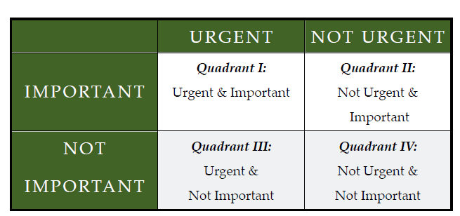
This time management tool is a grid composed of 4 quadrants, which you use to organize your to do list based upon urgency and importance
Quadrant I is for the
immediate and important deadlines.
Quadrant II is for long-term strategizing and development.
Quadrant III is for time pressured distractions. They are not really important, but someone wants it now.
Quadrant IV These are activities that are often used for taking a break from time pressured and important activities.

Slide 13
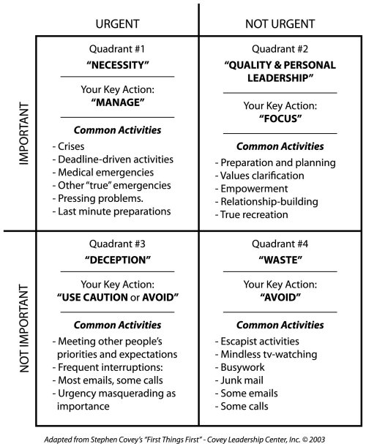
Time Matrix – help you determine the importance and urgency of each activity.

Slide 14
Where are you spending more of your Time?
The majority of my time will be spent or was spent in Quadrant(s): __________________
Too much time in Q3 and Q4 leads to:
  Stress
  Cramming for exams
  Reading at the last minute
  Declining GPA

Slide 15
Where Should You Spend your Time?
Q2 is the place to be
Try to spend the majority of time in Q2 doing important but not-urgent tasks (e.g., planning, personal development, readings).
Q2 tasks permit you to prepare for Q1 tasks without unnecessary pressure.
Being in Q2
  Yields better learning outcomes (self-efficacy & better grades)
  Brings stability to your life
  Helps you to be more prepared
  Reduces stress

Slide 16
The first and most obvious use of the grid is take your current ‘to-do’ list and sort all the activities into the appropriate grid. Then, assess the amount of time you have to accomplish the lists and, if necessary, reallocate activities. Place less emphasis (during crunch time avoid all together) on Q3 and Q4 activities
The second approach is a one week assessment strategy. Make six copies of the grid (you will find a working copy on the next page) and use one grid for each day of the week, listing all activities and time spent. At the end of the week, Combine the five individual day data onto one summary grid (number 6) and calculate the percent of time in each grid. Then evaluate how well your time is spent and whether you work load needs to be reor- ganized.
How to use the Covet time management tool

Slide 17
Topics
Time management
Effective note taking
Active reading
Self Regulation/Metacognition
Milking your memory
Why students think they understand, when they dont

Slide 18
The most fundamental principle of efficient studying – the best use of your limited time – requires active, not passive learning.
  Active learning requires making decisions about the material – “Is this important?”, “How is this part organized?”, “Where does this fit into the ‘big picture’?”, “What is the precise definition of this term?”,“Where have I seen this in an earlier lecture?

Slide 19
Lets make your studying active, beginning with taking notes.
A very common mistake for students is to spend way to much time simply taking notes on what they are reading/viewing/listening to…this is passively collecting information.
Often, the student spends so much time doing this, there is no time left to actually study the material.
Make your note taking more efficient and active!

Slide 20
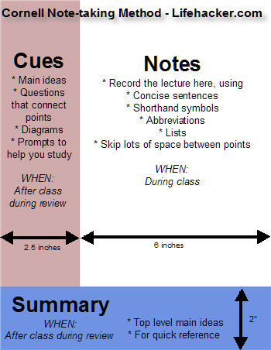
Cornell Note Taking Method

Slide 21
The 5Rs Process
Record - in the Note taking Column, record as many meaningful facts and ideas as you can in your own words. Use brief sentences, abbreviations, and symbols. Focus on testable information, “big ideas”, definitions, supporting details. Bullet, number, or indent key ideas.
Cue Column
Reduce ideas and facts to concise
jottings and summaries as cues for Reciting, Reflecting, and Reviewing.
Main ideas
Questions
Diagrams
Prompts
Reduce - summarize notes by writing single words, short phrases, and test questions in the Cue Column. Questions should focus on specific definitions and the “Big ideas”.
Summarizing clarifies meanings, reveals relationships, establishes continuity, strengthens memory and sets up a perfect stage for studying later for exams.
Recite - looking at the words and phrases in the Cue Column only, recite aloud and in your own words the full lecture. Use the test questions in the cue column to stimulate your memory and guide this process.
Reflect – thinking about the information, connecting it to your own experiences and other material discussed in class. Reflect asking yourself the following questions: What's the significance of these facts? What principle are they based on? How can I apply them? How do they fit in with what I already know? What's beyond them? How do the main ideas fit together into a “bigger picture”? What ideas are clear? Which are confusing? What new questions do I have? This will go into the summary section.
Review – spend some time every week reviewing your notes. This will help you to retain a great deal for current use, as well as later on for exams.
Summary
Leave space at the bottom of each sheet for a summary. Or, at the end of each reading section.

Slide 22
Example
Cues How do psychologists account for remembering? What’s a memory trace? There are three memory systems – sensory, short-term and long-term. How does sensory memory retain information? How is information transferred to STM? What are the retention times of STM? The capacity of the STM is 7 items. What are the six ways to transfer information from STM to LTM? How is the memory system applicable to teaching and learning? How can students enhance their memory system? | Psych. 105 Prof. Martin – Sept 14 (Mon.) Memory Memory tricky – can recall instantly many trivial things of childhood, yet forget things recently worked hard to learn & retain. Memory Trace Fact that we retain information means that some change was made in the brain. Change called “Memory trace” “Trace” probably a molecular arrangement similar to molecular changes in a magnetic recording tape. Three memory systems: sensory, short term, long term. 1. Sensory a. Information sent to the brain by sight, sound, smell, taste, touch b. lasts 1-2 seconds 2. Short Term memory (STM) (lasts 30 seconds) a. “gateway” before information is moved into long-term memory b. Hold information temporarily c. Limited capacity (holds average of 7 items) d. To hold items in STM must rehearse 3. Long-Term memory (LTM) (lasts a lifetime or short time). Transfer fact or ideas by: a. Associating with information already in LTM b. Organizing information into meaningful units. c. Understanding by comparing and making relationships d. Frame working – fit pieces in like a jigsaw puzzle e. Reorganizing – combining new and old into a new unit. f. Rehearsing – aloud to keep memory trace strong.
Summary: Three kinds of memory systems are sensory, which retain information for about 1-2 seconds; short term, which retains for a maximum of 30 seconds; and long-term, which varies from a lifetime of retention to a relatively short time. The six ways (activities) to transfer information to the long term memory are associating, organizing, understanding, frame working, reorganizing, and rehearsing.
Notes:
Source: https://www.google.com/search?q=cornell+note+taking+example+memory&safe=active&source=lnms&tbm=isch&sa=X&ei=NLsCUvXUIZb_4AP724CgDQ&ved=0CAcQ_AUoAQ&biw=1600&bih=1139#facrc=_&imgdii=_&imgrc=rHdqZcjqE_gcAM%3A%3BbnNl9VH90HSLDM%3Bhttp%253A%252F%252Fimg.gawkerassets.com%252Fimg%252F18fckyh47cu2hjpg%252Fku-medium.jpg%3Bhttp%253A%252F%252Flifehacker.com%252F202418%252Fgeek-to-live--take-study%252Bworthy-lecture-notes%3B320%3B566

Slide 23
What is concept mapping?
Concept Mapping
Concept mapping is a technique for organizing knowledge in a way that illustrates relationships between related concepts.
Concept maps consist of nodes and links.
Nodes represent concepts and links represent the relations between concepts.
This can be very valuable in connecting material from different points in the course or across courses

Slide 24
Purposes of Concept Mapping
To learn course material
  Students can use concept maps to take class notes.
  Students can use concept maps to organize class notes or course material.
To integrate course content
  Students can use concept maps to connect material learned throughout the semester.
To integrate material across different courses
  Often students fail to see the relationship between different classes that they have taken.
  Concept mapping can foster a student's understanding of how different courses relate if they map the prominent concepts from different courses that they have taken (e.g. compose one map of terms from a statistics class and a research design class).

Slide 25
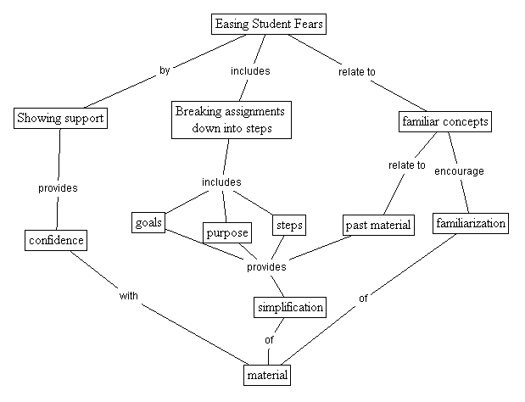
Example of a concept map

Slide 26
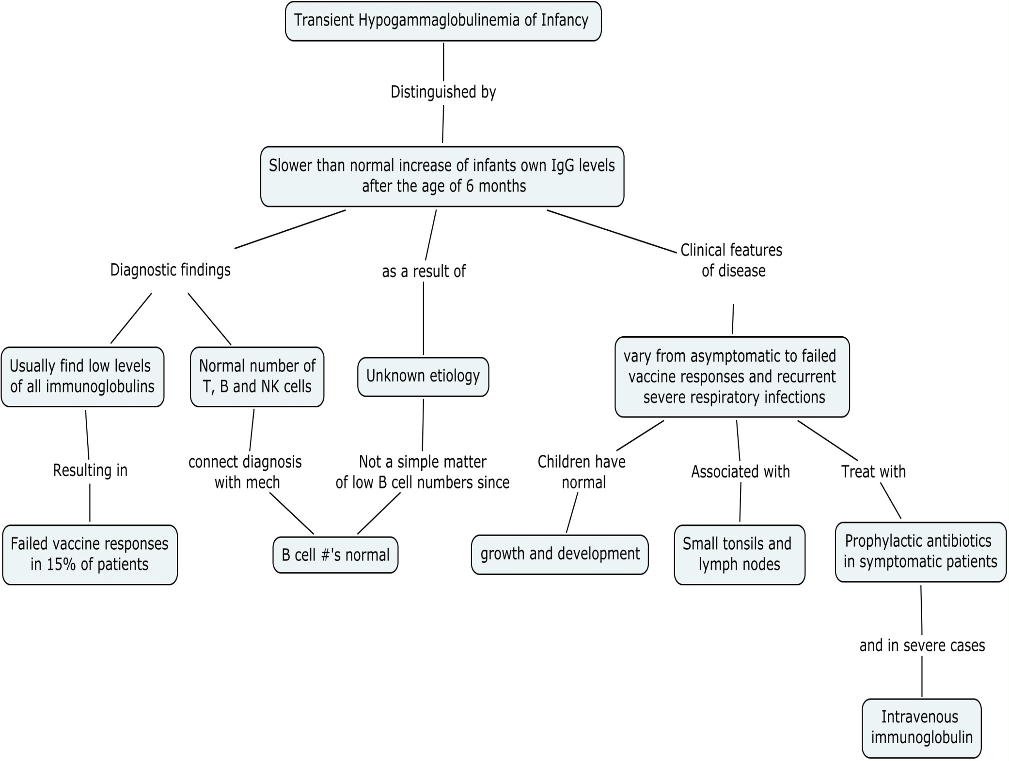

Slide 27

Reading for Comprehension
Reading is an ACTIVE process that must include thinking before,
during and after reading.

Slide 28
SQ4R Study Method
The SQ4R Method encourages active rather than passive reading.
In passive reading, one simply decodes the words without any mental engagement with the information in the text.
In active reading, one is deliberately seeking information from a text by asking questions, anticipating information to come, making connections with previously read material or formulating personal reactions.

Slide 29
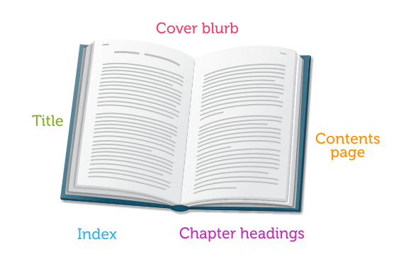
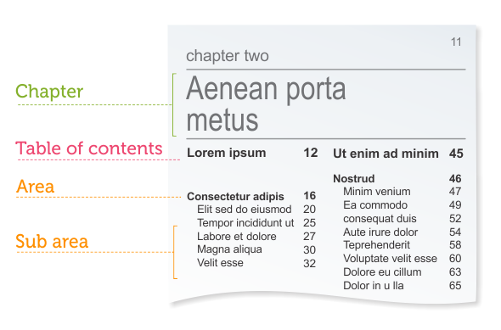
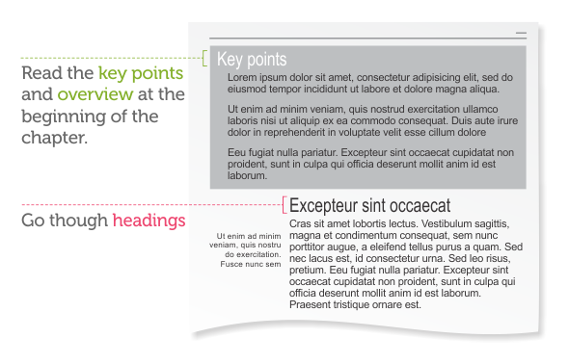
Step 1: Survey
Start from the big picture – gain an overview of the topic.
First look at:
  Table of contents in each chapter
  Abstract, summary, introduction
  Headings, subheadings, first sentence of each subsection
  Diagrams and charts
  Boldface print or italics
  Learning objectives
Ask yourself: What is it about? What is likely to be covered? How does this fit with what I already know about the topic?
Purpose - place the reading in context and activate any prior knowledge you have of the subject (long term memory)

Slide 30

Step 2: Question
While you are surveying:
Ask yourself, “what do I already know about this subject?” , “what did my instructor say about this chapter or subject?”
Turn the title, headings, and or subheadings into questions.
Read questions in introduction or at the end of the chapter or after each subheading.
Write down any questions that come to mind during the survey.
Topic: Activating the Learning Brain
Question: How can the learning brain be activated?
What are the steps/processes?
This will make the reading process a critical thinking
exercise and help to focus your
attention on information you need to get from the reading.

Slide 31
Step 3: Read Actively
When you begin to read:
Search for answers to the questions you raised
React to unclear passages - stop and reread parts which are not clear, generate additional questions about it.
Read only a section at a time and recite in your own words after each section.
Answer questions at the beginning or end of chapters or study guides.
Reread captions under pictures, graphs, etc.
Note all the underlined, italicized, bold printed words or phrases.
Study graphic aids.
Reduce your speed for difficult passages.
Take notes from the text using the Cornell Note Taking System.
Read in segments
Note pictures, graphs
Re-read difficult passages or reduce speed
Answer questions
Read to construct meaning from the text.

Slide 32
Step 4: Recite
After you’ve read a section:
Recall what was read - orally ask yourself questions about what you have just read and summarize it in your own words.
Recite answers to the questions/objectives.
Recite key terms and concepts.
Reread for unanswered questions/objectives before moving on.
Recite notes, better storage of information in your long term memory, and better understanding of the material.

Slide 33
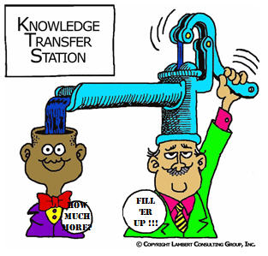
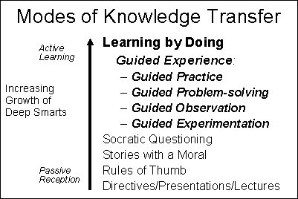
Step 5: Relate
Find personal application - it is easier to remember ideas that are personally meaningful.
Transfer or apply the information to the outer world - link new facts, terms, and concepts with information you already know.
The reading outcomes are not achieved unless transfer occurs. This is applying learning in one context to another related context and or to the outer world.

Slide 34
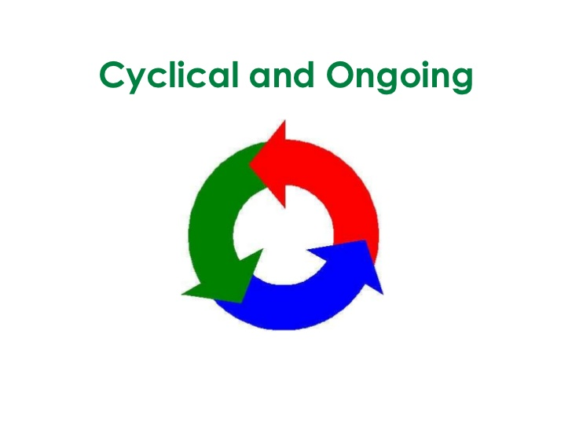
Step 6: Review
An ongoing process
When you’re done reading, skim back over the chapter, or read your notes.
Check your understanding by reciting and quizzing yourself again.
Make frequent review a key part of your study habits.
Make you a more self-aware learner. Also enhances
long-term memory storage for successful retrieval in the
future. Also studies show that with immediate and
ongoing review you can retain 80% of what you covered.
Therefore don't put off review until the night before the test.

Slide 35
Check for Understanding – Simple Strategies
One Minute Paper
  After reading each section stop and ask yourself the following two questions: "What was the most important thing you learned from this section of the reading?" and "What important question remains unanswered?" Record your response.
Muddiest Point
  Jot down "What was the muddiest point in ........?"
One sentence summary
  This simple technique challenges you to answer the questions "Who does what to whom, when, where, how, and why?" about a given topic, and then to combine those answers into a simple informative, grammatical, and long summary sentence.

Slide 36
Topics
Time management
Effective note taking
Active reading
Self Regulation/Metacognition
Milking your memory
Why students think they understand, when they dont

Slide 37
Stuck On An Escalator
Take Action
http://www.youtube.com/watch?v=FSIkjNaICsg&safe=active

Slide 38
What is Learning?
“Learning is not something that happens to students, it is something that happens by students.” - Zimmerman

Slide 39
Self-Regulated Learning (SRL)
SRL is a constructive, goal-directed process whereby learners attempt to proactively monitor, control, and regulate their learning (Pintrich, 2000).

Slide 40
Knowing how to know….
Build Your Metacognitive Knowledge
  How do you learn best?
  What settings are conducive to learning?
  What strategies work for you?

Slide 41
Becoming a self regulated learner
You begin a new block of material in the anatomy course
What happens between the time you are first introduced to the material and the date of your next exam?

Slide 42
Four Phases of Self Regulation
Forethought, planning, activation
Monitoring
Control
Reaction, reflection

Slide 43
Theoretical Framework
Four Phases of Regulation
Monitoring
Acting
Control Acting
Reaction
Reflection
Forethought
Planning
Activation
“Is this taking more time than I thought?”
“Am I understanding everything I need to understand?”
“Am I accomplishing what I hoped to?
“Am I being distracted?”
“When will I start working on this?”
“Where will I work?”
“How will I work?”
“What do I need to know or do to get this done?”
“What do I want to learn?”
“How much time do I need”
“What can I do to keep on task”
“I don’t think I’m getting this- what should I do to ensure that I understand everything that I need to understand?”
“What should I do differently?
“How can I encourage myself to get this done?”
Did I accomplish everything I had hoped to?”
“Did I do well – if so why?”
“Did I do poorly – if so why?”
What worked? What didn’t work?
“Did I plan enough time?”
“What should I do differently next time?”
*Pintrich & Zusho, 2007

Slide 44
The Development of Good Self-Regulation Involves
Self-observation
Self-judgment
Systematically monitoring
and keeping track of one’s
performance
Systematically comparing and
evaluating one’s performance
against a standard or goal
Self-evaluation
Systematically reflecting on
and improving upon one’s
performance

Slide 45
Topics
Time management
Effective note taking
Active reading
Self Regulation/Metacognition
Milking your memory
Why students think they understand, when they dont

Slide 46
Improve your memory!
Proven Strategies
Mnemonics
Chunking
Imagery
Memory Palace
Acronyms
Learning Strategies
Rehearsal
Elaboration
Organization
External Storage
Note-taking

Slide 47
You will be shown some words. Try to remember the letters in order.

Slide 48
CI AFB IKG BDN ABB C UKC NNU SA

Slide 49
Ready?

Slide 50
Let’s try again to remember the letters in order.

Slide 51
CIA FBI KGB DNA BBC UK CNN USA

Slide 52
READY?

Slide 53
Was the second memory task easier than the first?
Why?

Slide 54
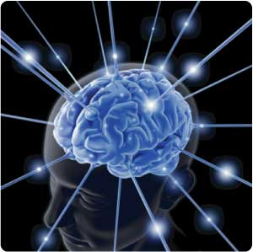
Power of Chunking
CI AFB IKG BDN ABB C UKC NNU SA
CIA FBI KGB DNA BBC UK CNN USA
Increases working memory capacity
by reducing memory load.
Improvement in speed as well as
accuracy on performance.
Notes:
J FKFB INAT OUP SNA SAI RS
JFK FBI NATO UPS NASA IRS

Slide 55
It is even easier when you make it into a story:
CIA FBI KGB DNA BBC UK CNN USA
The CIA, FBI and KGB are all searching for a spy's DNA. The story is reported on the BBC in the UK and CNN in the USA.
Your memory can remember lists much
more efficiently when you link all the
elements into a meaningful story.

Slide 56
Chunking in Medicine
In Medicine chunking can be done with lists of words or with pictures.
Example , a large list of antibiotics.
  They are easier to learn by first grouping them into categories (antibacterial, antifungal, antiviral, etc.)
  Antibacterials can be further reduced to the sub-chunks of penicillin family, anti-TB and leprosy, etc.

Slide 57
Imagery
Transforming verbal content (a word or concept) into visual information.
Often associated with better memory performance
Source of individual differences.
The ability to image improves with practice.
Can recall bizarre/unique imagery better than dull/routine imagery

Slide 58
Acronyms
The first letters of the items in a list are
put together to form a word.
The acronym SAMPLE is used to remember key questions for a person’s medical assessment:
S = Signs and symptoms
A = Allergies
M = Medications
P = Past medical history, injuries,
illnesses
L = Last oral intake and menstruation
E = Events leading up to the injury and or illness

Slide 59
Strategies for Long Term Storage
Elaboration
Adding additional ideas to new information based on
what one already knows.
Effective if the ideas added are appropriate inferences
Educational implication: Students must go beyond the information
itself – for example, to draw inferences and speculate about
possible implications
Mnemonics: Visual Imagery/Memory Palace
Forming a mental picture of information.
Especially beneficial when used to supplement
meaningful learning, organization, or elaboration.
Educational Implication: Students must illustrate verbal content
with visual materials (e.g., pictures, maps, diagrams).

Slide 60
Strategies for Long Term Storage
Rehearsal
Repeating information verbatim, either mentally or aloud.
Relatively ineffective - storage is slow, and later retrieval is difficult.
Educational Implication: Students should use as a last resort only.
Meaningful learning
Making connections between new information and prior knowledge.
Effective if associations made with prior knowledge are appropriate ones.
Educational implication: Students must connect new information to
things they already know
Organization
Making connections among various pieces of new information.
Effective if organizational structure is well laid out and consists of more than
just a “list” of separate facts.
Educational Implications: Students study and learn material in an
organized way, and know the organizational structure
and interrelationships in the material.

Slide 61
Topics
Time management
Effective note taking
Active reading
Self Regulation/Metacognition
Milking your memory
Why students think they understand, when they dont

Slide 62
Two general principles of how people gauge their memories
People often do not assess their knowledge directly by inspecting the contents of memory. Rather, they use cues such as familiarity and partial access.
Second, most of the time these cues provide a reasonable assessment of knowledge, but they are fallible.
  (Daniel T. Willingham (2003/2004)

Slide 63
Familiarity
Familiarity - is the knowledge of having seen or otherwise experienced some stimulus before, but having little information associated with it in your memory.
Fools our mind into thinking we know more than we do. Example, seeing someone and sensing that her face is familiar but being unable to remember who that person is or how we know her.
  (Daniel T. Willingham (2003/2004)

Slide 64
Familiarity
An insidious effect of familiarity is that it can give you the feeling that you know something when you really don't.
For example, it has been shown that if some key words of a question are familiar, you are more likely to think that you know the answer to the question (Reder, 1987).
Reder found that subjects were likely to say that they knew the answer to a question containing familiar words, irrespective of whether they could actually answer the question. For questions in which words had not been rendered familiar, subjects were fairly accurate in rapidly assessing their knowledge.
  (Daniel T. Willingham (2003/2004)

Slide 65
Partial Access
The knowledge that an individual has of either a component of the target material or information closely related to the target material.
For example, suppose I ask you a question and the answer doesn't immediately come to mind, but some related information does. Your quick retrieval of this partial information will lead to a feeling of knowing the relevant information — even if it is not actually in your memory (Koriat & Levy-Sadot, 2001).
Our mind is fooled when we know part of the material or related material.
  (Daniel T. Willingham (2003/2004)

Slide 66
How students end up with "familiarity" and "partial access" to material
Rereading - To prepare for an examination, a student rereads her classnotes and textbook. Along the way, she encounters familiar terms ("familiar" as in she knows she's heard these terms before), and indeed they become even more familiar to her as she rereads. She thinks, "Yes, I've seen this, I know this, I understand this." But feeling that you understand material as it is presented to you is not the same as being able to recount it yourself. Students usually spent a great deal of time reading over the course material, yielding a lot of familiarity, but not the necessary and richer recollective knowledge.
Shallow Processing – the deep meaning of a lesson will only reside in a student's memory if the student has actively thought about that deep meaning. If a student did not process and retain the deep meaning intended by the lesson but only absorb key terms his familiarity with these key terms could mislead him into believing he was ready for a test on the subject.

Slide 67
How students end up with "familiarity" and "partial access" to material
Recollecting Related Information - sometimes students know a lot of information related to the target topic, and that makes them feel as though they know the target information but haven’t yet come to understand the core issue.

Slide 68
Is your knowledge Superficial or Incomplete? Steps for Assessment..
The standard of "knowing" is the "ability to explain to others," not "understanding when explained by others.“
Articulate what you know in written or oral form, thereby making what you know or don't know explicit, and therefore easier to evaluate, and easier to build on or revise.
Begin each day (or selected days) with a written self test.
Do self tests at home or in preparing for examinations.
  (Daniel T. Willingham (2003/2004)
Notes:
Daniel T. Willingham is associate professor of cognitive psychology and neuroscience at the University of Virginia and author of Cognition: The Thinking Animal. His research focuses on the role of consciousness in learning.

Slide 69
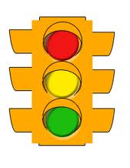
Final Assessment
I need to hear the information again – and
maybe in a new way – to understand it.
I remember a few things about the content
but need some review.
I know the content and can explain it to
another student.

Slide 70
Topics
Time management
Effective note taking
Active reading
Self Regulation/Metacognition
Milking your memory
Why students think they understand, when they dont

