Slide 1
Learning Styles

Slide 2
How Do I Learn Best?
VARK Learning Style Questionnaire
Copyright is held by Neil D. Fleming,
Christchurch, New Zealand.

Slide 3
A Guide to Learning Style - VARK
Visual - information in maps, diagrams, charts, graphs, flow charts, etc.
Aural - information that is "heard or spoken."
Read/Write - information displayed as words.
Kinesthetic - use of experience and practice (simulated or real).
Multimodality (MM) – a mixture of two or more preferences.

Slide 4
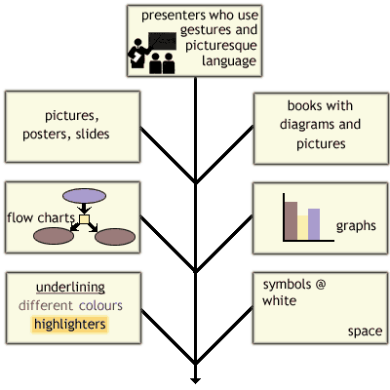
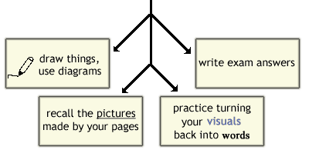
Visual Study Strategies
You want the whole picture so
you are probably holistic rather
than reductionist in your
approach. You are often swayed
by the way something looks.
You are interested in color and
layout and design and you know
where you are in your environment.
You are probably going to draw something.

Slide 5
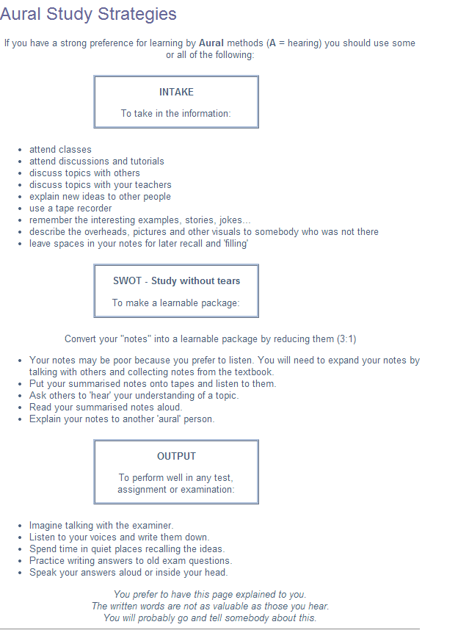

Slide 7
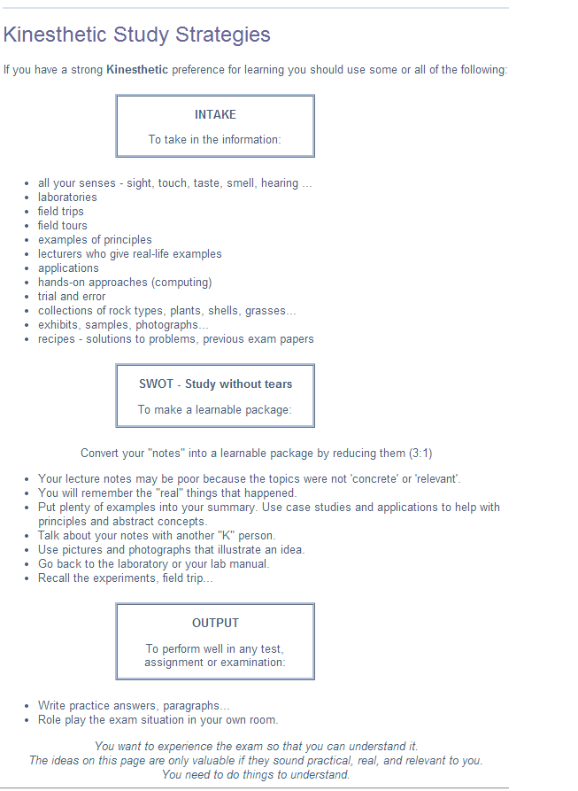

Slide 8
Understanding the Results These Cautions are Important
Your VARK scores indicate a learner’s preferences for the ways he/she takes in and expresses their learning. They may not indicate how you study, train, or work with others!
Preferences are not the same as strengths.
If you have completed the questionnaire with empathy you will have indicated the preferences of others - not your own learning preferences. Go back and do it for yourself.
Preferences may be masked by life and work experiences.

Slide 9
Preferences, Strengths, Skills, and Abilities
 |  | Strengths, Skills, and Abilities
 |  | I am good at it. | I am not good at it.
P R E F E R E N C E S | I Like it. | Go to it! Continue with your present strategies. Enhance them. | Develop it. Practice it. Use it. Try it.
 | I don’t like it. | Leave it till later. Motivation will void it. | Discard it. Don’t go there! Use your other strengths.

Slide 10
Is Your Preference Accurate and Helpful?
Questions to ask yourself:
How important is discussion (A), in your life?
How important is graphic (V) in your life?
How important is word (R) in your life?
How important is practice/experience (K) in your life?
Do you consider yourself an aural, visual, kinesthetic, read/write person?
Are there aspects of your life where your V or A or R or K preference is less important?
Are there aspects of your life where your V or A or R or K preference is really important?

